Slide 1
Trent Graduate Program Doctoral Scholarship Application Overview (SSHRC Focus) 2024-25
Jane Rennie
Graduate Finance Officer
School of Graduate Studies

Slide 2
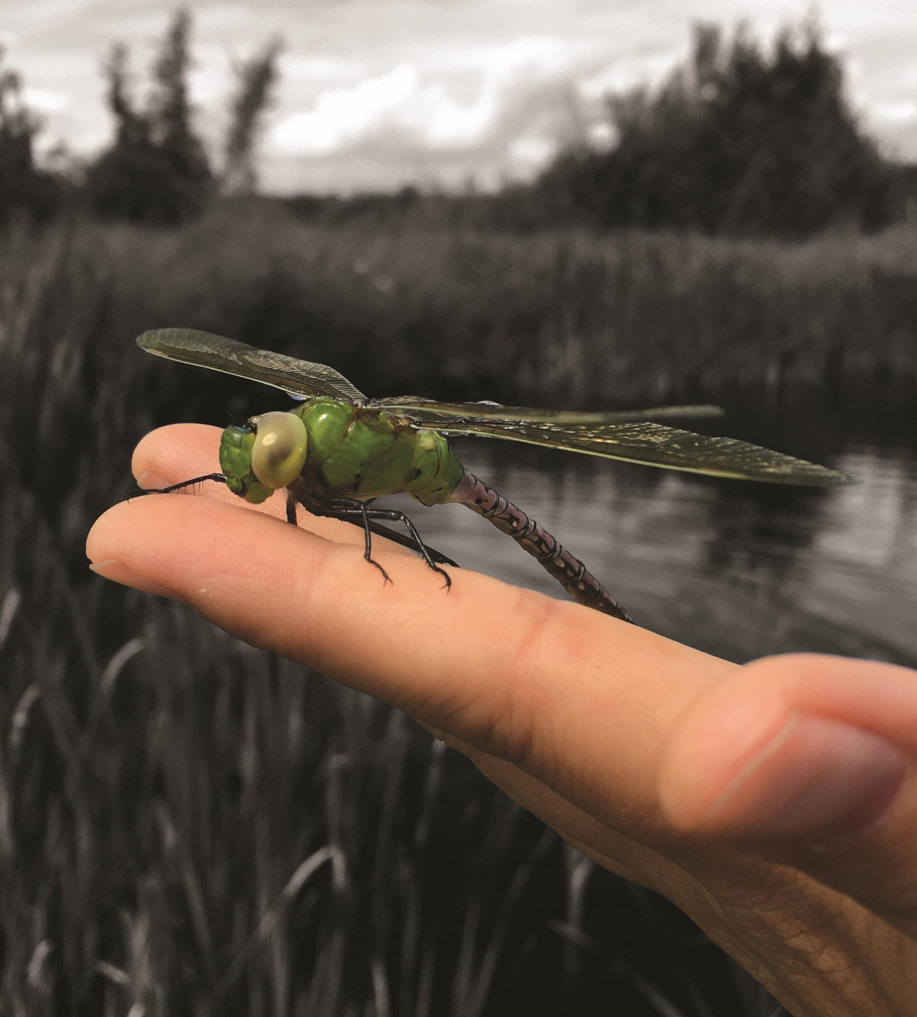
Financial Matters
Resources are available and applicants are encouraged to review the School of Graduate Studies under Financial Matters
Headings:
“How to Win Scholarships”
Tri-Council Resources
Graduate Studies Scholarship Application Resources
Many of these resources will also assist you with your academic research.

Slide 3
Various Types of Scholarships
As you begin your scholarship application activities it is important to understand the various types of scholarships:
Program Scholarships: entrance scholarships, awards and funding applications.
Donor Scholarships for Graduate Students
Government Scholarships which include Tri-Council scholarships, supplements, and the Ontario Graduate Scholarship
External Direct Application Scholarships
Paid Internships / Fellowships – such as MITACS Accelerate

Slide 4
Donor Scholarships
Donor scholarships have eligibility terms specific to the donor’s area of interest they wish to financially support.
It is important to review these criteria to ensure your qualifications fit the eligibility. Draft your application specific to the criteria of the scholarship.
Example: Thomas J. Bata Memorial Graduate Scholarship / William B. Reid Graduate Scholarship
Review opportunities: Scholarships and Awards

Slide 5
Thomas J. Bata Memorial Graduate Scholarship
This fund was established in honour of Thomas J. Bata (1914-2008), by his wife Sonja Bata and their family. Mr. Bata was one of Trent`s original honorary sponsors, a member of Trent’s Board of Governors between 1963 - 1973 and a close friend of Founding President Prof. T. H. B. Symons.
This $5,000 scholarship is intended to support a student that demonstrates leadership qualities such as innovation, entrepreneurship, community responsibility and global citizenship.
Deadline: October 7, 2024

Slide 6
Example External Direct Application Opportunities
Trudeau Foundation Doctoral Scholarship
Henry Mandelbaum Doctoral Fellowship Award
2025/2026 IODE War Memorial PhD Scholarships
Note the range of opportunities
The Laura Bassi Scholarship was established in 2018 with the aim of providing editorial assistance to postgraduates and junior academics whose research focuses on neglected topics of study, broadly construed, within their disciplines. The scholarships are open to every discipline and are awarded three times per year: December, April, and August. The value of the scholarship is remitted solely through editorial assistance as follows:
Master’s candidates: $750 Doctoral candidates: $2,500 Junior academics: $500
Updated regularly as notified of opportunities.

Slide 7
Tri Council Doctoral Scholarship Application

Slide 8
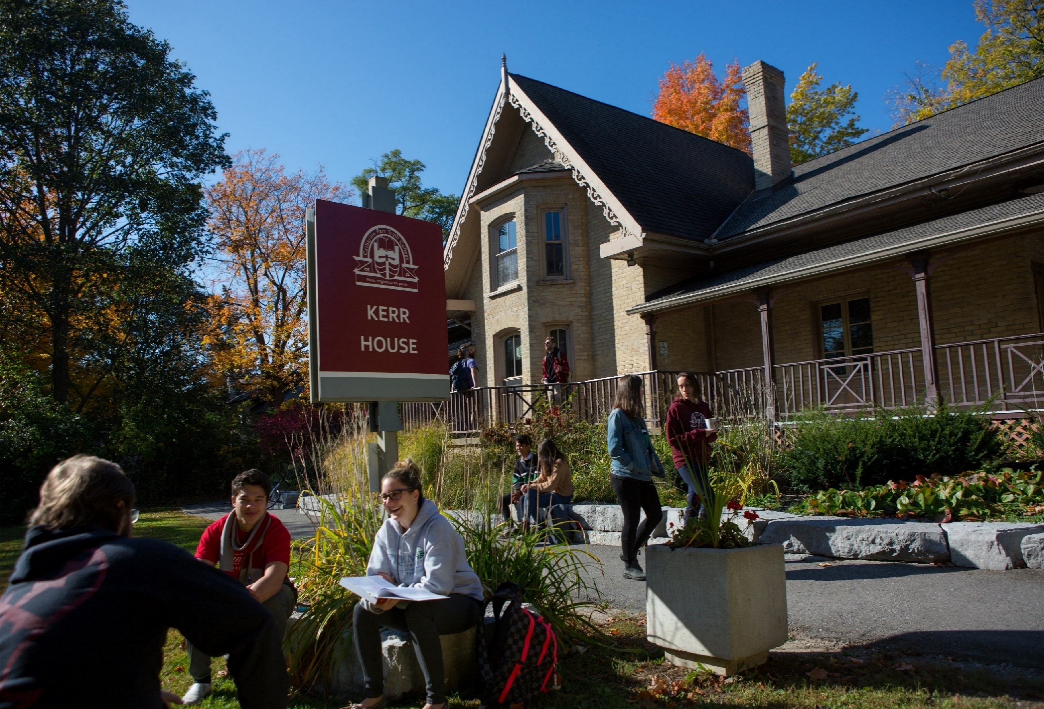
TRI COUNCIL DOCTORAL SCHOLARSHIP APPLICATION DEADLINE
Internal Trent Deadline
October 15, 2024, 11:59 p.m.
The various portals do not allow Trent to “close” access to the portals, but the School of Graduate Studies can view the last time the portal was accessed by the applicant.

Slide 9
Canada Graduate Scholarships – Doctoral Program
The objective of the Canada Graduate Scholarships – Doctoral (CGS D) program is to promote continued excellence in Canadian research by rewarding and retaining high-calibre doctoral students at Canadian institutions.
The CGS D program is a federal program of scholarships administered by the Natural Sciences and Engineering Research Council of Canada(NSERC), the Canadian Institutes of Health Research (CIHR) and the Social Sciences and Humanities Research Council (SSHRC).
Quota refers to the maximum number of applications an institutions can forward to each agency’s national competition.
Trent University has a separate quota for each agency at the doctoral level.
NSERC: Online system and Instructions
CIHR: ResearchNet and Instructions
SSHRC: Online system and Instructions

Slide 10
Agency-specific doctoral Awards
In addition to the CGS D, each agency has its own doctoral awards.
For all three agencies, only one application is completed and submitted to be considered for both a CGS D award and either an agency-specific doctoral award (for NSERC/SSHRC applications) or any available doctoral Priority Announcements (for CIHR applications).
CGS D awards are then offered for the top-ranked eligible applications in each agency’s competition. CIHR applicants who intend to hold their doctoral award abroad need to apply to the Doctoral Foreign Study Award (DFSA) program.
Some eligibility requirements for CGS D differ from those of the agency-specific doctoral awards. Refer to the appropriate literature for NSERC, CIHR and SSHRC for further details as well as information on doctoral awards tenable at foreign institutions.

Slide 11
ALWAYS Confirm your Eligibility
Refer to Tri-Agency CGS D website for complete eligibility requirement.
Reminder to carefully review the appropriate literature for CIHR, NSERC and SSHRC for further details on agency specific doctoral awards as eligibility requirements may vary.

Slide 12
Before you start a Tri-Council application
Review the General Guidelines for Eligibility of Subject Matter as it is critical to submit your application to the correct Agency.
After you have selected the correct Agency, review closely the CGS D and agency specific application overview.
Read the application instructions.
Notes:
Google Quota’s

Slide 13
SSHRC Recommends Reviewing Prior to Starting your application
Doctoral awards funding opportunity descriptions:
The Canada Graduate Scholarships—Doctoral Program (CGS D)
The SSHRC Doctoral Fellowships
Definitions of terms SSHRC uses in the application process
Regulations Governing Fellowship and Scholarship Applications
Guide to Including Diversity Considerations in Research Design for Doctoral and Postdoctoral Award Applicants
Guidelines for Effective Research Training
Guidelines for Research-Creation Support Materials (if applicable)
Letter of Appraisal form—Instructions for referees

Slide 14
Selection Review
The review aims to identify candidates for the award and create a ranked list of meritorious applicants.
Only materials submitted through the Research Portal are considered.
Any excess pages are removed before the review begins.
Committee members will not refer to external URLs or publications for additional information.
The merit review must adhere to the specified selection criteria, which are weighted.
Committee members consider each criterion when assigning a global score to an application.

Slide 15
Selection Criteria
Institutional review
The School of Graduate Studies is responsible for coordinating the institutional evaluation of all applications submitted from each agency.
Based on institutional quota, the highest ranked applications are forwarded to the federal competition.
Selection criteria
Research ability and potential (50% weight)
Relevant experience and achievements obtained within and beyond academia (50% weight)
Applicants are encouraged to review the indicators which help articulate the selection criteria

Slide 16
Vanier Selection guide
The Vanier Committee Selection Guide is a goldmine of resources for all applicants drafting a scholarship application.
This document further defines the selection criteria for doctoral applicants and has a variety of valuable links to other significant Tri-Agency guidelines.
This guide is a great tool during the editing stage of drafting your Outline of Proposed Research, as this component of your application is one of the “sources” used to assess the selection criteria.
Criterion - defines the selection criteria
Indicators - explanations of the concepts that demonstrate how the applicant meets the selection criteria
Sources - what component of the application provides an opportunity to demonstrates the applicant meets the selection criteria

Slide 17
CGS Doctoral Application Components
1. Research proposal (maximum two pages)
2. Bibliography and citations (maximum five pages)
3. Transcripts – include up-to-date official transcripts of all your undergraduate and graduate studies.
4. Allowable inclusions (if applicable Special Circumstances)
5. Research contributions, relevant experience and activities (maximum two pages)
6. Referees (two required)
*Applicants are encouraged to review the detailed instructions as they complete their application.

Slide 18
Instructions Step by Step Guide to completing a SSHRC Application
Application process & deadlines
Application profile
Program information
Areas of study
Research proposal
Bibliography and citations
Diversity considerations in research design module
Transcripts
Allowable inclusions (if applicable)
Research contributions, relevant experience and activities
Supplement justification (if applicable)
Joint or special initiatives justification (if applicable)
Referees

Slide 19
Outline of Proposed Research Various Proposal Frameworks
Hour-Glass Style
Inverted Triangle
Background of research, broad overview
Introduce important concepts, what is known and what is unknown
Research question
Methodology
Data analysis
Contribution to knowledge in field and broader impact
Big picture, relevance/importance of problem
Theoretical Frame: Situate study in body of theory
Research question
Methodology: Underlying approach to the research
Method: How will you do it?
Data analysis
Dissemination of research

Slide 20
Humanities framework Suggestion
Main challenge or issues (include the current understanding and the knowledge gaps that the proposed research aims to fill)
Research question
Proposed theoretical resources and methodological framework.
Methods
Data analysis
Contribution to knowledge: articulate how the knowledge you will produce contributes or advances your field and/or may transfer to other areas of research/fields
Contribution to the public good/social impact

Slide 21
Transcripts
Include up-to-date official transcripts of ALL your undergraduate and graduate studies in the application.
Up-to-date official transcripts are defined as transcripts issued by the Registrar’s Office and dated or issued in the fall session of the year of application or after the last term completed.
Applicants are responsible for collecting, uploading, and confirming legibility of previous and current transcripts and upload them directly on to the application portal.
If you have started your doctoral graduate program Fall 2024 – you must upload transcript from this program, as it indicates months of study in your graduate program.
Review the application instructions.

Slide 22
Special Circumstances: what to consider
Tri Council applications asks their selection committees to consider special circumstances that could have affected applicants’ research, professional career, record of academic or research achievement, or completion of degrees.
Relevant circumstances could include administrative responsibilities, maternity/parental leave, child rearing, illness, disability, cultural or community responsibilities, socio-economic context, family responsibilities, trauma and loss, the COVID-19 pandemic, or other applicable circumstances.

Slide 23
Include within special Circumstances
Applicants are asked to describe any special circumstances that may have delayed, disrupted, or interrupted studies or research, or otherwise affected the performance on which the assessment for funding will be made.
Note: If your current or past supervisor is unable to provide you with a recommendation letter, you should provide an explanation within the Special Circumstance

Slide 24
Writing Tips
Be brief, yet honest, when completing a special circumstances inclusion.
Stay factual and concise.
Assess your full application to determine if there are gaps requiring clarification for the members of the adjudication committee.
Demonstrate how the circumstances may have influenced your research, strengthened your focus, or broadened your academic development.

Slide 25
Scholarship Application Recommendation Letters
Recommendation letters might be called:
Letter of Appraisal
Report on the Applicant
Reference Assessment or Referee Assessment
Recommendation letters are a significant part of the evaluation of an applicant.
It is critical that a “referee” relate their comments to the competition’s selection criteria.
They provide a meaningful commentary on an applicant’s skills, knowledge, experience, research potential.
Adjudication committee members rely on these letters to review their own ranking of the application in comparison to the pool of applicants.
Always review the instructions provided to referees

Slide 26
Who? When? How?
Consider
How to ask
Who to ask?
A person who offers authority, depth and who is able to offer specificity. They are familiar with your research and other abilities:
Supervisor, faculty member, employment supervisor, thesis advisor
When to ask?
… early, 3 weeks before scholarship due date
Email or in-person or phone
What is your comfort level and awareness of your referee?
If in email, first message should:
Be a brief inquiry reminding the faculty member how you know them
Provide clarification as to what scholarship application you are applying for
Clearly ask if they are willing to provide an enthusiastic reference for your scholarship application
Provide the scholarship application submission deadline

Slide 27
What to provide a referee and what might be helpful
Advise your referee you will provide:
Scholarship details & selection criteria
Draft of your outline of proposed research
Referee instructions
Due date for recommendation letter submission
Ask, would it would be helpful to provide:
unofficial transcripts;
a resume or CCV;
written blurbs for how your experience or academic background fits the selection criteria of the scholarship competition

Slide 28
A strong Reference will:
Confirm the value of your research project
Demonstrate how your research will function within the broader community
Indicate a familiarity with your academic achievements to date
Endorse your project and your ability to achieve the outcomes of your project
Provide a robust picture of your skills and interest in and outside the lab / classroom
Highlight how you may have overcome challenges or any special circumstances that you have experienced during your academic career

Slide 29
Next Steps
Create an account – don’t fear the application portal!
Submit early – during the last days possible portal overload.
Your Outline of Proposed Research takes time to draft and skill to incorporate the required concepts within the allowable space
Ask your Supervisor or a valued faculty member to review your full draft application
Follow the steps to ask for Letter of Recommendations (ideally 3-4 weeks prior to the submission deadline)
Review presentation standards and confirm your allowable page maximums

Slide 30
Research Funding concepts

Slide 31
Equity, Diversity & Inclusion
The academic research funding ecosystem must create a culture where embedding equity, diversity and inclusion (EDI) considerations into all aspects of research is second nature.
Incorporating EDI considerations in your proposal and throughout your application, where relevant, can strengthen your application. This will be taken into consideration by the selection committee members during the adjudication process.
Tri-Agency Resources:
Guide for Applicants: Considering Equity, Diversity and Inclusion in your Application
Equity, Diversity and Inclusion (multiple)

Slide 32
Sex and Gender Based Analysis + (SGBA+)
When applicable, indicate how diversity (gender, sex, age, race, culture, religion, etc.) is considered in your proposed research (from its design to the analysis of the research findings).
Incorporating the principles of SGBA+ in research has the potential to increase the thoroughness and usefulness of the research.
How to Integrate Sex and Gender into Research

Slide 33
Knowledge Mobilization
Knowledge mobilization is an umbrella term encompassing a wide range of activities relating to the production and use of research results, including knowledge synesis, dissemination, transfer, exchange, and co-creation or co-production by researchers and knowledge users.
Resources from Tri-Council
What is knowledge mobilization?
Knowledge mobilization and merit review at SSHRC
Outcomes and impacts
Turning research into outcomes and impacts
Related policies and web links
Examples

Slide 34
Guides for Assessment of Contributions
Other guides that help clarify your qualifications include:
Guidelines on the Assessment of Contributions to Research, Training and Mentoring
San Francisco Declaration on Research Assessment (DORA)
* These links are filled with valuable information necessary to produce a winning application

Slide 35
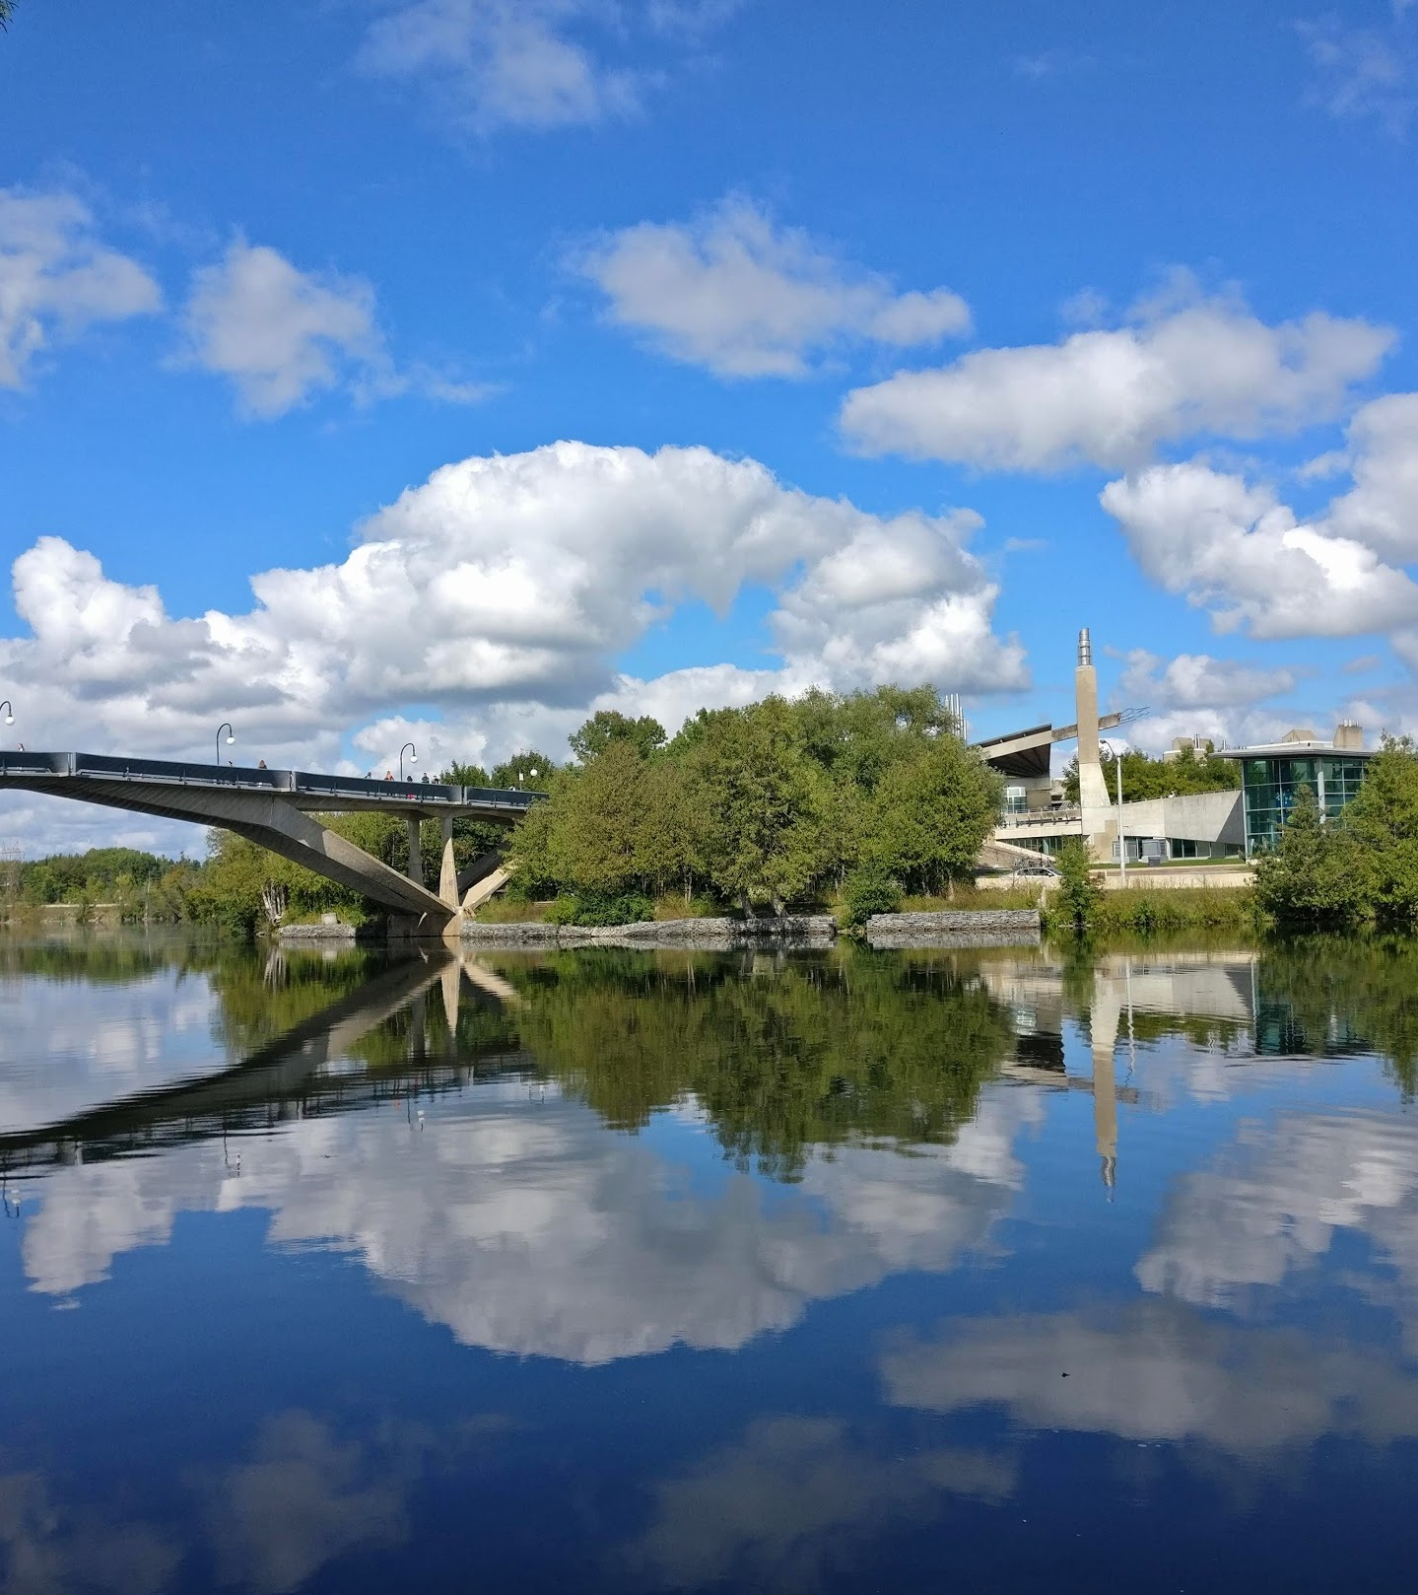
Indigenous Resources and Indigenous Research
If you identify as an Indigenous student there are multiple resources available to assist you develop your scholarship application.
Contact the School of Graduate Studies, Finance Officer Jane Rennie janerennie@trentu.ca for one-to-one support.
If you are engaged in Indigenous Research Tri-Agency has several policies, guidelines, and resources available.

Slide 36
Research Involving and Engaging Indigenous Peoples
Below are SSHRC resources to support applicants working in Indigenous research; merit reviewers assessing applications related to Indigenous research; and communities and other research partners engaged in Indigenous research:
Definition of Indigenous research
Guidelines for the Merit Review of Indigenous Research
Indigenous Advisory Circle
Indigenous Leadership Circle in Research
Indigenous Research Statement of Principles
Tri-Council Policy Statement: Ethical Conduct for Research Involving Humans Chapter 9: Research Involving the First Nations, Inuit and Métis Peoples of Canada

Slide 37
Benefits of Developing Scholarship applications
Enhances your ability to communicate your research clearly to non-academic audiences, avoiding jargon.
Provides exposure to the complexities and technical challenges of government portals and instructions.
Improves your academic and discipline specific writing skills, as consistent practice leads to greater proficiency.
By working task-to-task, you gain a better grasp of the time and planning required to complete projects on deadline.
Provides essential experience, enabling you to confidently mentor young researchers through the scholarship application process.

Slide 38
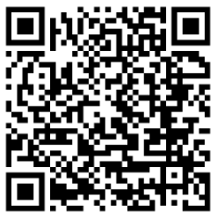
“Financial Matters” Jane Rennie Graduate Finance Officer Coordinator of all Graduate Scholarships janerennie@trentu.ca
Workshop Registration:

Slide 39
School of Graduate Studies Blackburn Hall, Suite 115 All financial inquires direct to: graduatefinance@trentu.ca

