Slide 1
Tri-Council Canada Graduate scholarships – Master’s program 2024-25

Slide 2
Types of Graduate Scholarship or Funding Opportunities
As you begin your scholarship application activities and or applications to graduate programs, it is important to understand the various types of scholarships:
Entrance Scholarships - outlined in your offer of admission to a graduate program
Donor funded scholarships
Government Scholarships which include Tri-Council scholarships, and the Ontario Graduate Scholarship
Paid Internships / Fellowships – such as MITACS Accelerate

Slide 3
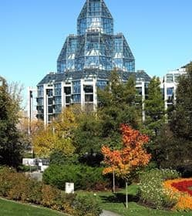
Tri Agency / Tri council
CIHR- Canadian Institute of Health Research
The intended outcomes of the research must, as stated in CIHR’s mandate, primarily improve or have an impact on the health and or produce more effective health services and products and or strengthen the Canadian health care system.
NSERC – Natural Sciences and Engineering Research Council
The intended objective(s) of the research must primarily be to advance knowledge in one or more of the natural science or engineering disciplines.
SSHRC – Social Sciences and Humanities Research Council
The intended outcome of the research must primarily be to add to our understanding and knowledge of individuals, groups, and societies – what we think, how we live and how we interact with each other and the world around us.
Notes:
The Canadian Institutes of Health Research (CIHR), the Natural Sciences and Engineering Research Council of Canada (NSERC) and the Social Sciences and Humanities Research Council of Canada (SSHRC), “the Agencies,” are federal government granting agencies entrusted with managing public funds to enable and support a world-class, Canadian research enterprise.

Slide 4
Tri Agency Postgraduate Programs
Tri-Council Canada Graduate Scholarships – Master’s Program (CGS-M)
Value: $27,000
Canadian Deadline: December 1, 2024
DESCRIPTION
The CGS M program supports up to 3,000 students annually in all disciplines and is administered jointly by Canada’s three granting agencies.
The selection process and post-award administration are carried out at the institutional level under the guidance of the three agencies.
Students select, within their application the institution at which they intend to hold their award using the Research Portal.
*Application Research Portal is hosted by NSERC for all applicants regardless of their area of research
Notes:
The CGS M program provides financial support to high-calibre scholars who are engaged in an eligible master’s or, in some cases, doctoral program in Canada (refer to the Eligibility section for more information).
This support allows these scholars to concentrate more fully on their studies in their chosen fields.

Slide 5
First Tasks
Review applicant eligibility prior to commencing application
Review program of study eligibility
Field of research and subject matter eligibility

Slide 6
First Class Average at Trent is 80%
Eligibility Summarized
Canadian citizen, or permanent resident
Enrolled or have applied for FT studies in an eligible Canadian graduate program
Have completed, as of Dec 31 of the year of application 0 – 12 months of FT studies in the program for which you are requesting funding
Have achieved a first-class average, as determined by the host institutions, in each of the last two completed years of study (full time equivalent)
*students should review this section completely for the details
Typically, if the applicant is in 4th year of their undergraduate studies, the grades used will be:
UG Third year
August 31, 2024, to September 1, 2023
UG Second year
August 31, 2023, to September 1, 2022
First year Graduate Student – grades used:
UG fourth year
August 31, 2024, to September 1, 2023
UG third year
August 31, 2023, to September 1, 2022

Slide 7
Program of Study Eligibility
An eligible graduate program must include a significant research component that leads to the completion of a thesis, major research project, dissertation, scholarly publication, performance, recital and/or exhibit that is merit/expert reviewed at the institutional level as a requirement for completion of the program.
Trent applicants may contact: graduatefinance@trentu.ca to clarify program of study eligibility for a CGS M

Slide 8
Before you start a Tri-Council application
For any given submission, applicants must apply to the agency that is responsible for the dominant research discipline or area as defined by the agencies' General Guidelines for the Eligibility of Subject Matter
Tri Council has specific guidelines related to scholarship applications related to Health and Psychology
Notes:
Google Quota’s

Slide 9
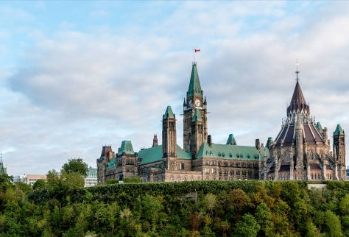
Quick Reference – Agency Research Funding Mandate's
NSERC – Natural Sciences and Engineering Research Council
The intended objective(s) of the research must primarily be to advance knowledge in one or more of the natural science or engineering disciplines.
SSHRC – Social Sciences and Humanities Research Council
The intended outcome of the research must primarily be to add to our understanding and knowledge of individuals, groups, and societies – what we think, how we live and how we interact with each other and the world around us.
CIHR- Canadian Institute of Health Research
The intended outcomes of the research must, as stated in CIHR’s mandate, primarily improve or have an impact on the health and or produce more effective health services and products and or strengthen the Canadian health care system.

Slide 10
Tri Council CGS –M Application

Slide 11
Canada Graduate Scholarships – Master’s Program
The application platform (Research Portal) is now open and opens every September.
The Deadline is December 1st
Bookmark this page – all resource links are grouped together
Research Portal
Canadian Common CV portal link
Program Resources:
Canada Graduate Scholarships – Master’s program
Canada Graduate Scholarships – Master's program: Instructions for completing an application
Canada Graduate Scholarships – Master’s program: Instructions for completing a Canadian Common CV
Canada Graduate Scholarships – Master’s program: Instructions for completing the reference assessment form
Tutorial videos
Applicants are well guided step-by-step through the application process!
Financial Matters – Upcoming Workshops
Notes:
Task-by-task guidelines

Slide 12
$ Supplements / joint initiatives $
Steps for completing and submitting your CGS M application
Create an application
Application overview (supplements/joint initiatives)
Activity details (special circumstances)
Outline of Proposed Research
Transcripts
Canadian Common CV
Reference assessments
Verify that the application is complete
Extract the application
Submit application
Accept the terms and conditions of applying
Department of National Defence Mobilizing Insights in Defence and Security (MINDS) scholarship initiative
Canada Mortgage and Housing Corporation (CMHC) SSHRC Housing Research Scholarship Program
Black Scholars Initiative
Indigenous Scholars Awards and Supplement Pilot Initiative (SSHRC & NSERC)
$$ These supplements/joint initiatives are ADDITIONAL funding opportunities within the CGS M application (Step 2 instructions)

Slide 13
Selection Criteria
Academic excellence (weight 50%)
As demonstrated by past academic results, transcripts, awards and distinctions
Research potential (weight 30%)
As demonstrated by your research history, your interest in discovery, the proposed research, its potential contribution to the advancement of knowledge in the field and any anticipated outcomes
Personal characteristics and interpersonal skills (weight 20%)
As demonstrated by your past professional and relevant extracurricular interactions and collaborations
Applicants should consider the indicators of the assessment criterion when drafting their winning scholarship application.

Slide 14
Selection Review Process
The review identifies candidates for the CGS M award and creates a ranked list of meritorious applicants and alternates.
Only materials submitted through the Research Portal will be considered.
Any excess pages are removed before the review begins.
Committee members will not refer to external URLs or publications for additional information.
The merit review must adhere to the specified selection criteria, which are weighted.
Committee members must consider each criterion when assigning a global score to an application.
No additional criteria may be added.

Slide 15
REMINDER: 11 Tasks to complete the CGS M application
Create an application
Application overview (includes Supplements/joint initiatives)
Activity details (special circumstances)
Outline of proposed research (attachment) with bibliography and citations
Transcripts (attachment)
Canadian Common CV
Reference assessments (two reference assessments)
Extract the application
Submit the application
Accept the terms and conditions of applying
*instructions are provided within each task

Slide 16
Special Circumstances: what to consider
Tri Council applications asks their selection committees to consider special circumstances that could have affected applicants’ research, professional career, record of academic or research achievement, or completion of degrees.
Relevant circumstances could include:
administrative responsibilities,
maternity/parental leave, child rearing,
illness, disability,
cultural or community responsibilities,
socio-economic context,
family responsibilities,
trauma and loss,
the COVID-19 pandemic,
or other applicable circumstances.

Slide 17
Include within special Circumstances
Applicants are asked to describe any special circumstances that may have:
delayed, disrupted, or interrupted studies or research,
or otherwise affected the performance on which the assessment for funding will be made.
Note: If your current or past supervisor is unable to provide you with a recommendation letter, you should provide an explanation within the Special Circumstance

Slide 18
Writing Tips
Be brief, yet honest, when completing a special circumstances inclusion.
Stay factual and concise.
Assess your full application to determine if there are gaps requiring clarification for the members of the adjudication committee.
Demonstrate how the circumstances may have influenced your research, strengthened your focus, or broadened your academic development.

Slide 19
Outline of Proposed Research Various Proposal Frameworks
Hour-Glass Style
Inverted Triangle
Background of research, broad overview
Introduce important concepts, what is known and what is unknown
Research question
Methodology
Data analysis
Contribution to knowledge in field and broader impact
Big picture, relevance/importance of problem
Theoretical Frame: Situate study in body of theory
Research question
Methodology: Underlying approach to the research
Method: How will you do it?
Data analysis
Dissemination of research

Slide 20
The Process
Complete your first, second and third draft of your Outline of Proposed Research (writing this component of your application takes time to draft and skill to incorporate the required concepts within the allowable space)
Ask your Supervisor or a valued faculty member to review your full draft application
Follow the steps to ask for Letter of Recommendations (ideally 3-4 weeks prior to the submission deadline)
Review presentation standards and confirm your allowable page maximums

Slide 21
Transcripts
Include up-to-date official transcripts of ALL your undergraduate and graduate studies in the application.
Up-to-date official transcripts are defined as transcripts issued by the Registrar’s Office and dated or issued in the fall session of the year of application (if currently registered) or after the last term completed (if not currently registered).
Applicants are responsible for collecting, uploading, and confirming legibility of previous and current transcripts and upload them directly on to the application portal.
If you have started your M.A. or M.Sc. graduate program Fall 2024 – you must upload transcript from this program, as it indicates months of study in your graduate program.
Review the application instructions.

Slide 22
Canadian Common CV
This is not your personal resume uploaded to your application.
When apply to the Canada Graduate Scholarships – Master’s (CGS M) program, follow the instructions to complete the CGS M Canadian Common CV (CCV) and upload it to your application.
Instructions
On this page
Registering and logging in
Selecting the CGS M CCV
Completing the CGS M CCV
Editing and adding entries
Submitting the CGS M CCV
Uploading the CGS M CCV

Slide 23
Scholarship Application Recommendation Letters
Recommendation letters might be called:
Letter of Appraisal
Report on the Applicant
Reference Assessment or Referee Assessment
Recommendation letters are a significant part of the evaluation of an applicant.
It is critical that a “referee” relate their comments to the competition’s selection criteria.
They provide a meaningful commentary on an applicant’s skills, knowledge, experience, research potential.
Adjudication committee members rely on these letters to review their own ranking of the application in comparison to the pool of applicants.
Always review the instructions provided to referees

Slide 24
Who? When? How?
Consider
How to ask
What is your comfort level and awareness of your referee?
Would you: Email or in-person or phone
If in email, first message should:
Be a brief inquiry reminding the faculty member how you know them
Provide clarification as to what scholarship application you are applying for
Clearly ask if they are willing to provide an enthusiastic reference for your scholarship application
Provide the scholarship application submission deadline
Who to ask?
A person who offers authority, depth and who is able to offer specificity. They are familiar with your research and other abilities:
Supervisor, faculty member, employment supervisor, thesis advisor
When to ask?
… early, 3 weeks before scholarship due date

Slide 25
What to provide a referee and what might be helpful
Advise your referee you will provide:
Scholarship details & selection criteria
Draft of your outline of proposed research
Referee instructions
Due date for recommendation letter submission
Ask, would it would be helpful to provide:
unofficial transcripts;
a resume or CCV;
written blurbs for how your experience or academic background fits the selection criteria of the scholarship competition

Slide 26
A strong Reference will:
Confirm the value of your research project
Demonstrate how your research will function within the broader community
Indicate a familiarity with your academic achievements to date
Endorse your project and your ability to achieve the outcomes of your project
Provide a robust picture of your skills and interest in and outside the lab / classroom
Highlight how you may have overcome challenges or any special circumstances that you have experienced during your academic career

Slide 27
Research Funding concepts (helpful Resources)

Slide 28
Equity, Diversity & Inclusion
The academic research funding ecosystem must create a culture where embedding equity, diversity and inclusion (EDI) considerations into all aspects of research is second nature.
Incorporating EDI considerations in your proposal and throughout your application, where relevant, can strengthen your application. This will be taken into consideration by the selection committee members during the adjudication process.
Tri-Agency Resources:
Guide for Applicants: Considering Equity, Diversity and Inclusion in your Application
Equity, Diversity and Inclusion (multiple)

Slide 29
Knowledge Mobilization
Knowledge mobilization is an umbrella term encompassing a wide range of activities relating to the production and use of research results, including knowledge synesis, dissemination, transfer, exchange, and co-creation or co-production by researchers and knowledge users.
Resources from Tri-Council
What is knowledge mobilization?
Knowledge mobilization and merit review at SSHRC
Outcomes and impacts
Turning research into outcomes and impacts
Related policies and web links
Examples

Slide 30
Guides for Assessment of Contributions
Other guides that help clarify your qualifications include:
Guidelines on the Assessment of Contributions to Research, Training and Mentoring
San Francisco Declaration on Research Assessment (DORA)
* These links are filled with valuable information necessary to produce a winning application

Slide 31
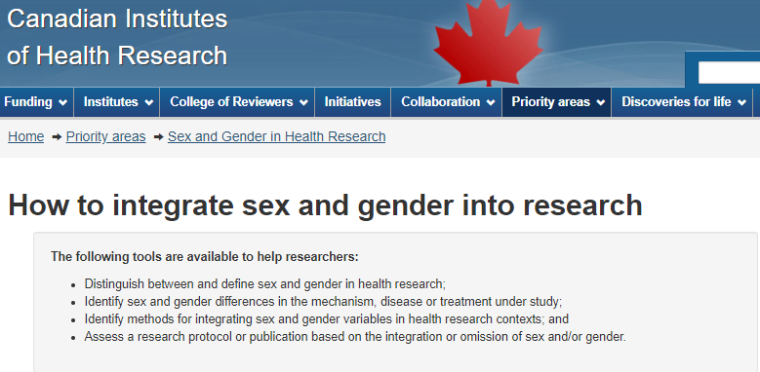
Sex and Gender Based Analysis + (SGBA+)
When applicable, indicate how diversity (gender, sex, age, race, culture, religion, etc.) is considered in your proposed research (from its design to the analysis of the research findings).
Incorporating the principles of SGBA+ in research has the potential to increase the thoroughness and usefulness of the research.
CIHR hosts resources for this concept:
How to Integrate Sex and Gender into Research

Slide 32
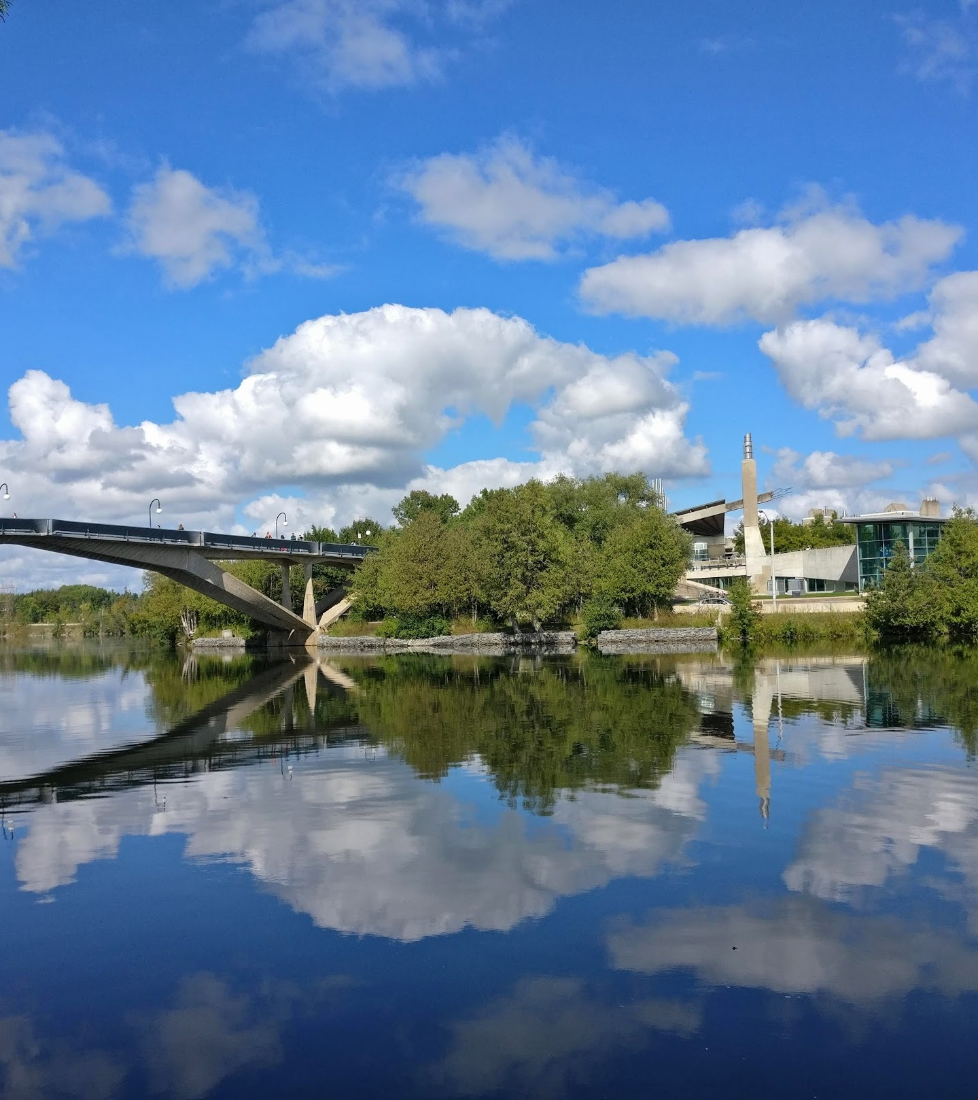
Indigenous Resources and Indigenous Research
If you identify as an Indigenous student there are resources available to assist you develop your scholarship application.
Contact the School of Graduate Studies, Finance Officer Jane Rennie janerennie@trentu.ca for one-to-one support.
If you are engaged in Indigenous Research Tri-Agency has several policies, guidelines, and resources available.

Slide 33
Benefits of Developing Scholarship applications
Enhances your ability to communicate your research clearly to non-academic audiences, avoiding jargon.
Provides exposure to the complexities and technical challenges of government portals and instructions.
Improves your academic and discipline specific writing skills, as consistent practice leads to greater proficiency.
By working task-to-task, you gain a better grasp of the time and planning required to complete projects on deadline.
Provides essential experience, enabling you to confidently mentor young researchers through the scholarship application process.

Slide 34
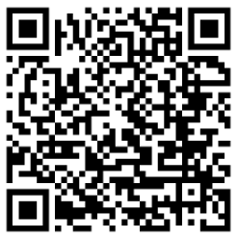
“Financial Matters” Jane Rennie Graduate Finance Officer Coordinator of all Graduate Scholarships janerennie@trentu.ca
Workshop Registration:

Slide 35
School of Graduate Studies Blackburn Hall, Suite 115 All financial inquires direct to: graduatefinance@trentu.ca

