Slide 1
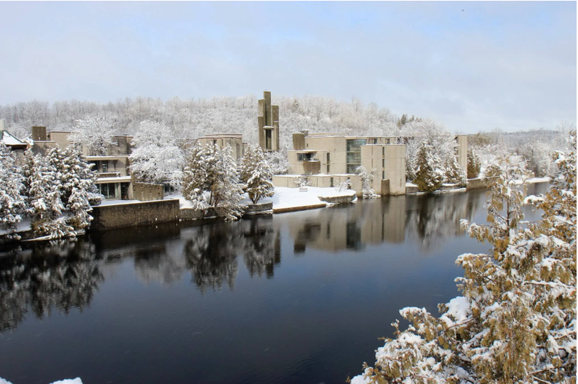
Graduate Student Tuition & Fees Graduate Student Account & Funding 2024-25

Slide 2
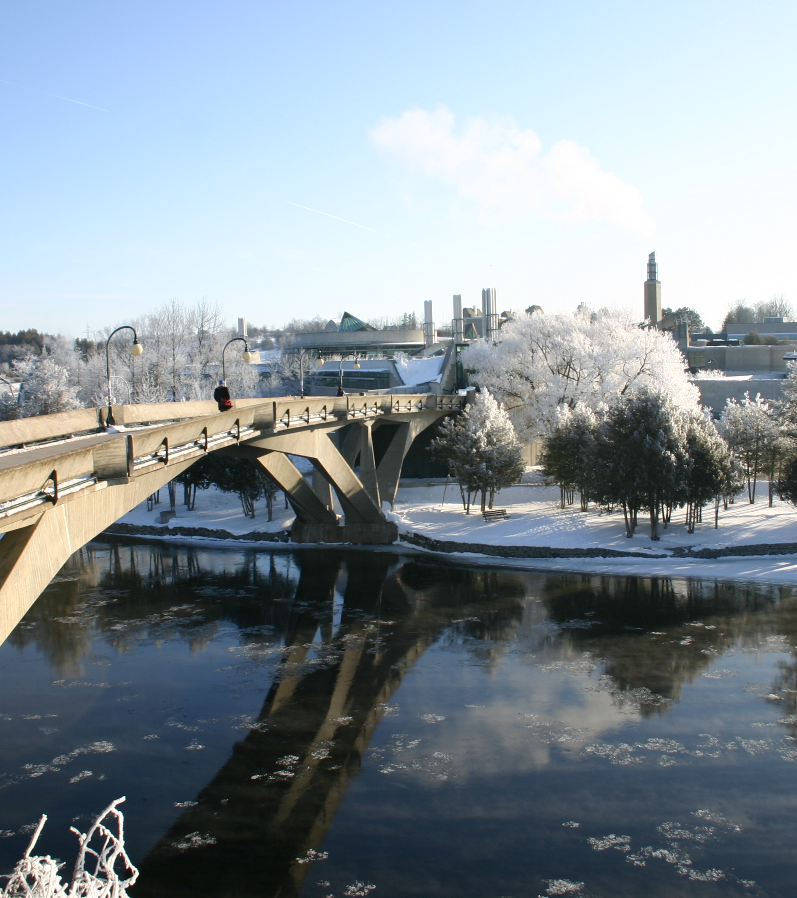
Graduate Tuition Fees
Graduate tuition fees vary between research/thesis-based programs and professional programs. For full details on graduate fees for the 2024-2025 academic year, please refer to the appropriate fee schedule. Fees are subject to approval by the Trent University Board of Governors and the yearly fee schedule is posted by September of each academic year. Fees for graduate studies are billed per term or per course (programs vary) and fees are based upon year of entry into a graduate program at Trent University. Tuition fees are subject to increase each academic year. Trent’s academic year begins each September and ends each August. Fees for the upcoming academic year are published on our website each July.

Slide 3
Student Accounts & Tuition
Graduate Tuition Fee Deadlines
Fall Term: September 28, 2024
Winter Term: January 28, 2025
Summer Term: May 28, 2025
You must be registered in your program’s placeholder for your tuition billing to be applied to your student account.
Billing is applied 2-3 weeks prior to the start of a new term.
You can view your tuition in the myTrent portal:
myTrent > Finance > My Account > Account Statement.
Please check your program’s 2024-25 tuition fees before the start of term, as they have increased beyond the estimate provided in your admission letter. It is important to review your student account regularly, especially after registration changes.

Slide 4
Tuition Payments
Payment options are divided into categories. Select the category that best suits your financial scenario on the Making a Payment webpage.
Payment Methods for Registered students
Payment Methods for Applicants & for Students who have Accepted their Offer of Admissions
Making a Successful Convera Payment
Payments Methods for Students Receiving OSAP
Payment Methods for Third Party Sponsored Students
Payment Methods for Inactive Students
Students can choose to enroll in payment plans to pay tuition by increments over the term, instead of paying the entire amount by January 28, 2025.
Winter term payment plan enrollment closes January 19, 2025.

Slide 5
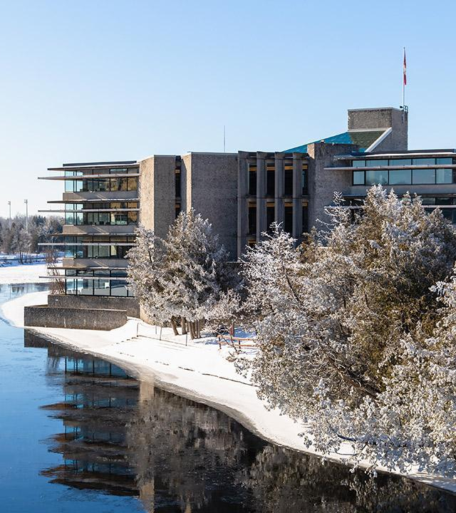
Important Additional Information
Financing with Private Lenders – Important Process Information
While students may opt to seek financing for their education through private lenders, please be aware that Trent University will not issue refunds greater than the student's Trent-related expenses (tuition, ancillary fees, meal plans, and ON-campus housing).
Students who are borrowing funds to pay for OFF-campus housing and other living expenses should arrange for funds to be deposited directly into their personal bank account.
Late Fees and Returned / Declined Payments
It is the student's responsibility to ensure that their payment(s) are received by the Student Accounts Office on or before the due date(s).
A late charge of $100.00 is applied to all accounts with a late payment and interest will accrue. An additional fee of $40 will be charged for all returned payments.

Slide 6
Scams in Canada
All students can be victims of scams (fraud) but international students are more vulnerable because they are new to Canada​
Scammers exploit international student fear getting in trouble with the Government of Canada or being deported. ​
No employer, government agency, or police will ask you to send money over the phone or through email or threaten to deport you.​
Be suspicious of any communication which seems strange or threatening.
If in doubt, ask someone in Trent International or School of Graduate Studies or Trent Security!
If you are victim of a scam:
Contact local police
File a report with Canadian Anti-Fraud Centre (1-888-495-8501)
Share your story with others
Contact Trent International for guidance, and advise other relevant uuniversity departments such as Housing, Student Accounts, or the School of Graduate Studies.
Notes:
https://www.trentu.ca/graduatestudies/financial-matters/student-account-and-tuition

Slide 7
Health & Dental Benefits
Health & Dental Benefits
Opting-Out: Peterborough full-time and Durham students are automatically enrolled in and billed for Health and Dental plans. If you already have coverage through your parent’s plan or personal employment, you may submit an online request to opt-out through the Trent Central Student Association (TCSA).
Students who complete a valid opt-out, will receive their refund as arranged by the association after the start of the term.
Please visit this website for more information.
Questions?
Trent Central Student Association (TCSA) - Peterborough students
Call 705-748-1000 or visit www.trentcentral.ca
Opt-Out Deadlines Apply:
September 1 - September 30 (September-start students)
January 1 - January 31 (January-start students)
For more information about opting in or out, as well as plan coverage, visit https://www.studentvip.ca/Default.aspx
Notes:
https://www.trentu.ca/graduatestudies/financial-matters/student-account-and-tuition

Slide 8
Graduate Student Accounts & Graduate Funding

Slide 9
Admissions Letter: Total financial support
Keep your Offer of Admission letter as it includes valuable financial information
Review your Graduate Student funding outline which is the second page of your Offer of Admission for:
Source of funding (name)
Years offered
Total Funding Support
Additional Information about your Funding – an important section as it elaborates on your funding and university processes and policies
Notes:
To submit questions about your student account you must communicate using your Trent University email account.

Slide 10
Graduate Teaching Assistantships (GTA)
Graduate Teaching Assistantship (GTA) is a form of employment. Full-time graduate students assigned a GTA must be available to work on campus during the period of employment.
Trent University and the Ontario Council on Graduate Studies are committed to the principle that full-time graduate students are employed no more than an average of 10 hours per week. GTAs are processed bi-weekly through Payroll as an electronic funds transfer directly to your personal bank account between September and April.
On the Graduate Student Funding page of your Offer of Admission, the department that you have been assigned to is provided along with the terms you have been approved to hold a GTA.
For further information on GTA’s email: gradta@trentu.ca

Slide 11
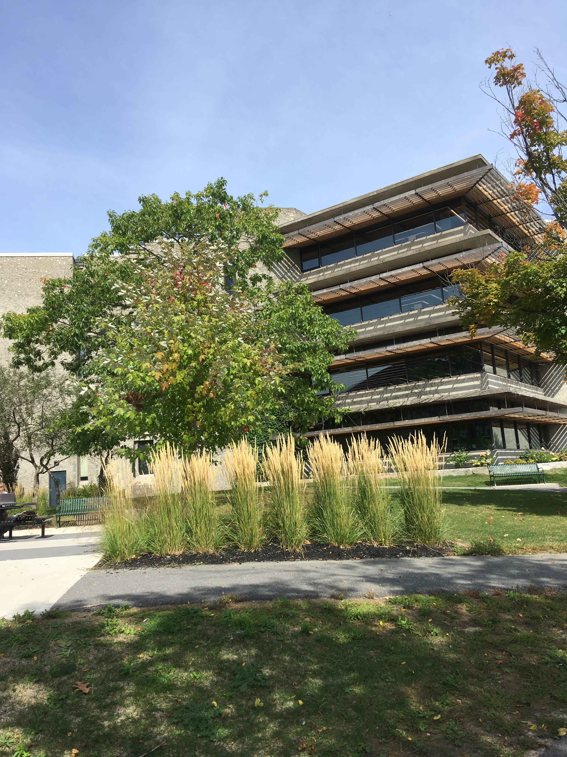
Funds posted to Student Account
Graduate Research Fellowships
SGS Academic Scholarship
SGS Research Fellowship Award
Dean’s PhD Scholarship
International Graduate Scholarship
These types of funds are posted to student accounts by the end of the third week of the first month of each academic term.

Slide 12
Entrance Scholarships
All entrance awards with a value of $3,000 or less, are posted to the student account during a student’s first academic year. Entrance scholarships are a form of graduate funding, which is posted to student accounts by the end of the third week of the first month of the academic term.
Entrance awards of $3,000 or more: the first $3,000 is posted during the first month of the academic year, and the remainder is split between the second and third term, unless otherwise explained differently on your Graduate Student Funding page.
These funds are posted to student accounts by the end of the third week of the first month of each academic term.

Slide 13
Research Fellowship Awards (RFA)
RFA support typically comes from a student’s Supervisor.
Generally, this type of funding is for students in science graduate programs. Review your Graduate Student Funding page for the value of this support.
Payment distribution typically consists of smaller amounts in fall and winter, with final payout in spring term. The distribution should be discussed with your Supervisor.
Supervisor will email the Graduate Funding Form 1B to graduatefinance@trentu.ca prior to September 10th, January 10th, or May 10th.
The Finance Team receives and processes funding forms, sending a complete listing to the Office of Research & Innovation, who review and approve Supervisor RFA support.
The Finance Team is advised that the approval process has been completed and RFA funding is posted to a student’s account.
NOTE: Navigating approval process can take time, all efforts are taken to ensure the funding is posted to student accounts prior to the tuition deadline.

Slide 14
External Scholarships
Types of Scholarships:
Tri-Council’s Doctoral Scholarships
Tri-Council Canada Graduate Scholarship – Master’s Program
Ontario Graduate Scholarship & Queen Elizabeth II Ontario Graduate Scholarship in Science & Technology
PLUS: Any direct applicant scholarships that have requested Trent University to post to a student’s account.
Once all necessary documentation has been submitted and confirmed, Trent University will receive the funds for these scholarships on your behalf and post to your student account. These funds are posted to student accounts by the end of the third week of the first month of each academic term. Students submit a credit refund request form for the funds to be moved to a student's personal bank account.

Slide 15
Bursary Support for Financial Need
The general bursary program for graduate students at Trent University is administered by the Financial Aid for domestic and international graduate students. Many students need some form of financial assistance to achieve their academic goals.
The application is available, at the beginning of each term: myTrent > Finance > Financial Aid
Online Application Deadlines
Fall Deadline: September 30, 2024
Winter Deadline: January 31, 2025
Spring Deadline: May 23, 2025

Slide 16
Refund Information
A credit balance occurs when you have more funds in your account than what has been billed or charged to your account.
It is important to review your student account regularly. You can find your account statement online in the myTrent portal:
myTrent > Finances > My Account > Account Statement There are various scenarios that creates a credit balance in your student account. It is important to understand how the credit balance is created to determine which area within the university is responsible to process your credit refund.

Slide 17
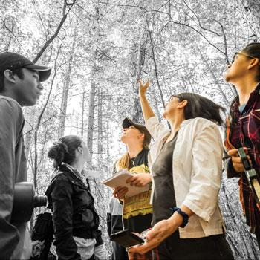
Student Refunds: Bursaries & Financial Aid
Defined: Students eligible for this type of refund have received provincial government financial aid and or have received a graduate domestic or international bursary.
These types of requests are processed by the Financial Aid Office.
The refund request form is found on the myTrent portal:
myTrent > Finances > Financial Aid > Financial Aid Refund Request
For further questions contact: financialaid@trentu.ca

Slide 18
Student Refunds: Refunding Credit on student Account
Reason for a credit balance:
Graduate funding
External scholarships
Tuition overpayment
External loan cost of living allowance
These types of requests are processed by the School of Graduate Studies.
The refund request form is found on the myTrent portal:
myTrent > Finances > Financial Aid > Graduate Refund Request (Credit on Account)
For further details contact: graduatefinance@trentu.ca

Slide 19
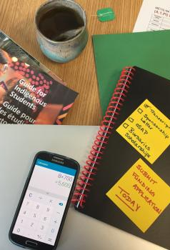
Finance Connections Around Campus
The Financial Aid Office at Trent processes Ontario Student Assistance Program (OSAP) applications for graduate students, as well as assists with the facilitation of the graduate bursary application. While OSAP is only available to Ontario students, both international and domestic students are welcome to apply for a bursary.
Graduate Studies & OSAP
As a graduate student you are eligible to receive OSAP funding. Our office strongly encourages you to apply for fall/winter and then complete an OSAP Change of Information form on the myTrent portal for the summer term.
This would give you the ability to receive a disbursement for fall/winter and then summer as well.
For more information about OSAP as a graduate student review the Financial Aid Office materials posted for graduate students, not undergraduate students.

Slide 20
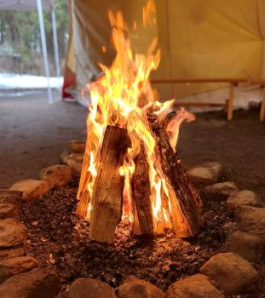
Indigenous Student Financials
First Peoples House of Learning (FPHL) offers cultural services to a diverse community of Indigenous learners (First Nations, Status/Non-Status, Métis, and Inuit). They collaborate with students to support their academic success, personal development and leadership potential. In addition to their student students, FPHL provides information on financial opportunities for Indigenous students. Check out the FPHL Financial Assistance page for more information. If you have any questions or concerns about financial matters, please contact the Indigenous Student Success Coordinator at fphlstudentsuccess@trentu.ca or (705) 748 1011 extension 7358. You can also directly Book a Meeting.

Slide 21
Academic Year 2024 – 2025 Don’t forget

Slide 22
Graduate Scholarships & Awards
How to Win Scholarships
We encourage all graduate students to carefully review the scholarship opportunities posted.
They are sorted in categories of federal, provincial, and internal donor-funded scholarships.
Each funding competition is unique and needs to be reviewed to determine eligibility.
Other External Direct Application Opportunities are updated as the School of Graduate Studies is advised of new opportunities. Students are encouraged bookmark page.
This page is a valuable source for a wide variety of resources related to applying for scholarships for graduate students.
We encourage you to refer to this website frequently as these resources will be helpful throughout your time as a graduate student.
Upcoming Workshops
Graduate Studies Scholarship Application Resources
Tri-Council Resources
CV/Resume Help: Career Space

Slide 23
School of Graduate Studies Blackburn Hall, Suite 115 All financial inquires direct to: graduatefinance@trentu.ca

