Slide 1
School of Graduate Studies Scholarship Application Outline of Proposed Research 2024-25

Slide 2
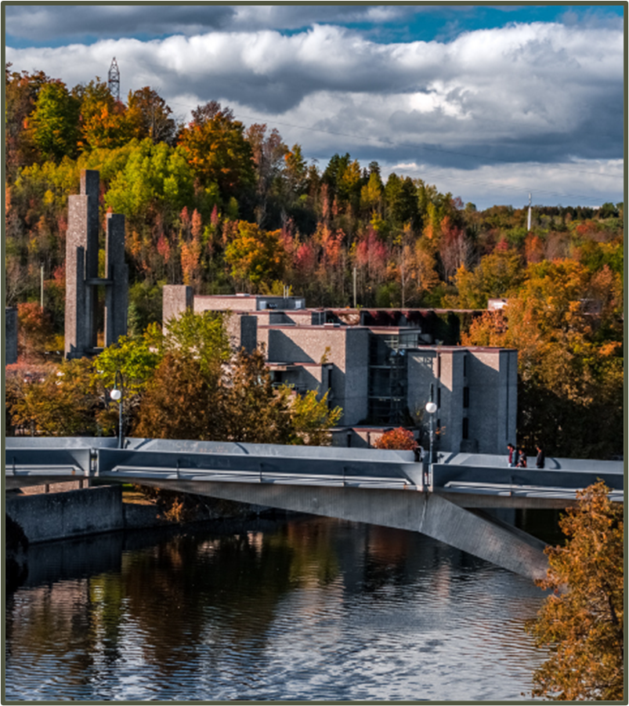
Competition Instructions
It is challenging to develop a winning scholarship application if you do not read the scholarship program description completely first and understand all its required components.
Every Tri-Agency competition has a “General Information” section with key points.
In the Outline of Proposed Research section of a scholarship application, review guidelines, presentation standards, and required inclusions prior to commencing your application.
Trent Tri Agency Competitions:
Canada Graduate Scholarships – Master’s Program instructions, scroll to review Outline of Proposed research
Canada Graduate Scholarships – Doctoral Program scroll to “Application forms and instructions” and the instructions are provided for each agency NSERC, SSHRC, CIHR
Vanier Canada Graduate Scholarships review “Application / Nomination process > Instructions to applicants

Slide 3
Tri Council Ph.D Outline of Proposed Research Instructions

Slide 4
NSERC Ph.D. Instructions Outline of Proposed Research
In the Outline of Proposed Research section of your application, provide the requested information according to the guidelines and format standards outlined in the NSERC online presentation and attachment standards webpage.
Provide a detailed yet concise description of your proposed research project for the period during which you are to hold the award.
Be as specific as possible.
Provide background information to position your proposed research within the context of the current knowledge in the field.
State the significance of the proposed research to a field or fields in the Natural Sciences and Engineering.
State the objectives, hypothesis, and outline the experimental or theoretical approach to be taken (citing literature pertinent to the proposal) and the methods and procedures to be used.
If the proposed research is a continuation of your thesis, clearly state the differences between work done for your thesis and the research activities outlined in this proposal.
Write your proposal in clear, plain language, and avoid jargon. Your application will be evaluated by a review committee covering a broad discipline category.
NSERC expects you to write your research proposal independently and to properly reference ideas or text belonging to others.
NSERC encourages you to seek feedback from colleagues and supervisors.
Include all relevant information in the outline. Do not refer review committee members to URLs or other publications for supplemental information. Such additional information will not be reviewed.

Slide 5
SSHRC Ph.D. Instructions
Write your proposal in clear, plain language.
Avoid discipline-specific jargon, acronyms, and highly technical terms.
Your application will be reviewed by members of a multidisciplinary selection committee, not all of whom will be familiar with your area of research.
Ensure that your text includes the following required elements, especially with respect to your research proposal.
clearly state your current level of graduate study;
indicate at what stage you are in your thesis/research project;
provide the name of your supervisor of your studies, if known;
provide an outline of your thesis or research project, including, for example, the research question(s), context, objectives, methodology, significance and expected contributions to advancing knowledge; and
describe what you hope to accomplish during the award tenure and what will remain for you to complete to obtain your degree.

Slide 6
CIHR Instructions (Ph.D)
Different Requirements: 2 Parts
1. Training Expectations
Describe their experiences/achievements and how it will contribute to their training success.
Describe how the training they expect to acquire will contribute to their professional development and career goals and to the research goals they hope to achieve.
Describe how their expected training strives to foster impacts within and beyond the research environment and will contribute to the Canadian research ecosystem during and beyond the tenure of the award.
Explain why they decided to obtain training at the proposed institution and what they expect to learn from the training experience.
2. Research Project Summary
Should clearly describe the applicant's role in the project.
Should be written in general scientific language, which is an important skill to acquire for future success in the research environment as applications are being reviewed by multi-disciplinary committees.
Should be specific, focused, include feasible research question(s), objective(s) and provide a clear description of the proposed methodology.

Slide 7
Tri Council M.Sc. / M.a. Outline of Proposed Research Instructions

Slide 8
Canada Graduate Scholarship – Master’s Program Instructions
The single attachment consists of two separate sections: Outline of proposed research and Bibliography and citations.
Each of these sections must be only one page.
Pages in excess of the number permitted may be removed before the selection process, and your application may be at a disadvantage as a result.
If you have not yet decided on a specific project, you must still provide a detailed description of a proposed research project. You may change your research direction or activities during the course of the award. Certain restrictions may apply. Refer to the Tri-agency research training award holder’s guide.

Slide 9
NSERC / SSHRC / CIHR CGS M Instructions
Outline of proposed research (one page maximum)
Provide a detailed description of your proposed research project for the period during which you will hold the award.
Be as specific as possible.
Provide background information to position your proposed research within the context of current knowledge in the field.
State the objectives and hypothesis and outline the experimental or theoretical approach to be taken (citing literature pertinent to the proposal) and the methods and procedures to be used.
State the significance of the proposed research to a field or fields in the health sciences, natural sciences and/or engineering or social sciences and/or humanities, as appropriate.
Provide projected timelines for the research, including community consultation, plans for collaboration, and knowledge translation strategies.
Where applicable, address how your research complies with established research-related policies and protocols (e.g., protocols for conducting research respectfully involving and engaging the First Nations, Inuit and Métis Peoples of Canada; approvals for research involving the use of humans, animals or biohazards).
Notes:
When you review the various instructions, they indicate similar details and confirm that key information must be included within the Outline of Proposed Research

Slide 10
Possible Frameworks Outline of Proposed Research

Slide 11
Various Proposal Frameworks
Hour-Glass Style
Inverted Triangle
Background of research, broad overview
Introduce important concepts, what is known and what is unknown
Research question
Methodology
Data analysis
Contribution to knowledge in field and broader impact
Big picture, relevance/importance of problem
Theoretical Frame: Situate study in body of theory
Research question
Methodology: Underlying approach to the research
Method: How will you do it?
Data analysis
Dissemination of research

Slide 12
Humanities framework Suggestion
Main challenge or issues.
Brief synthesis of what is known/unknown about the challenge/issue (clearly illuminating the knowledge gaps that the proposed research will address).
Research question(s)
Proposed theoretical resources and methodological framework.
Proposed methods.
Contribution to knowledge: articulate how the knowledge you will produce contributes to advances in your field and/or may transfer to other areas of research/fields
Contribution to the public good/social impact.

Slide 13
Research Funding concepts (helpful Resources)

Slide 14
Equity, Diversity & Inclusion
The academic research funding ecosystem must create a culture where embedding equity, diversity and inclusion (EDI) considerations into all aspects of research is second nature.
Incorporating EDI considerations in your proposal and throughout your application, where relevant, can strengthen your application. This will be taken into consideration by the selection committee members during the adjudication process.
Tri-Agency Resources:
Guide for Applicants: Considering Equity, Diversity and Inclusion in your Application
Equity, Diversity and Inclusion (multiple)

Slide 15
Research Involving and Engaging Indigenous Peoples
Below are SSHRC resources to support applicants working in Indigenous research; merit reviewers assessing applications related to Indigenous research; and communities and other research partners engaged in Indigenous research:
Definition of Indigenous research
Guidelines for the Merit Review of Indigenous Research
Indigenous Advisory Circle
Indigenous Leadership Circle in Research
Indigenous Research Statement of Principles
Tri-Council Policy Statement: Ethical Conduct for Research Involving Humans Chapter 9: Research Involving the First Nations, Inuit and Métis Peoples of Canada

Slide 16
Sex and Gender Based Analysis + (SGBA+)
When applicable, indicate how diversity (gender, sex, age, race, culture, religion, etc.) has been considered in your proposed research (from its design to the analysis of the research findings).
Incorporating the principles of SGBA+ in research has the potential to increase the thoroughness and usefulness of the research.
How to Integrate Sex and Gender into Research

Slide 17
Knowledge Mobilization
Knowledge mobilization is an umbrella term encompassing a wide range of activities relating to the production and use of research results, including knowledge synesis, dissemination, transfer, exchange, and co-creation or co-production by researchers and knowledge users.
Resources from Tri-Council
What is knowledge mobilization?
Knowledge mobilization and merit review at SSHRC
Outcomes and impacts
Turning research into outcomes and impacts
Related policies and web links
Examples

Slide 18
Quick Tips
Read all instructions, ensure you are eligible prior to starting
Start early and create a timeline to complete tasks
Edit, review, and edit again
Concisely show how your research is innovative and valuable
Demonstrate that your research is feasible and will impact your field and beyond
Demonstrate familiarity with principles of equity, diversity, inclusivity, sex and gender-based analysis, knowledge mobilization/ transfer
Submit early to allow time for any technology difficulties

Slide 19
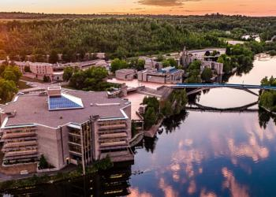
Resources for Scholarship Applications
Tri-Council Doctoral Applications- Where to Submit Application Flowchart
YouTube Scholarship Fellowship Application Tutorials
Guidelines on the Assessment of Contributions to Research, Training and Mentoring
Health Research Training at CIHR
Training Resources (“Career Hub”)
San Francisco Declaration on Research Assessment (DORA)

Slide 20
School of Graduate Studies Blackburn Hall, Suite 115 All scholarship Applications inquires direct to: graduatefinance@trentu.ca

