Slide 1
Working with tables and figures
Academic Skills, Trent University
2020
www.trentu.ca/academicskills

Slide 2
Why use a table or figure?
Help summarize your data.
Supplement and simplify explanations in your text.
Provide evidence to support an argument or idea.
Visually explain complicated trends or patterns.

Slide 3
Reflect and then create
Keep in mind who will be looking at your table or figure. Ask yourself – what do you want to explain to your reader?
Determine the type of data you will be presenting (i.e. discrete, continuous, or categorical).
Consider the best format to illustrate and explain your information. Should you use a table or figure? What type of figure?
Make it easy to understand (i.e. clear and accurate).
Always include a caption.

Slide 4
What is a table?
Tables
Data are organized in columns and rows by headings.
Logically arrange complex data.
Useful for comparing specific values or organizing multiple units of measurement.

Slide 5
What is a figure?
Figures
Data are depicted in graphs, maps, diagrams, photographs, or drawings.
Provide a concise visual presentation of your data.
Useful for showing the general trend, pattern, or relationship among many variables.

Slide 6
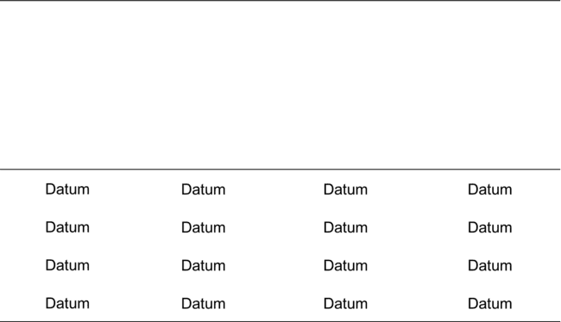
Tables

Slide 7
Step 1: Plan your table
Design a table so it is easy to read both horizontally and vertically.
Keep column and row headings simple but informative.
Consider drawing out the table on paper first before making an electronic version.

Slide 8
Step 2: Create and format your table
Software such as Microsoft Word or Excel can help you construct a table.
Double check that any calculations in your table are correct and the values make sense.
Make sure the table’s label, variable names, and data values match the label, names, and values referred to in the text.
Remember to indicate the units of measurement.
Align decimal points.
Be consistent with spacing, placement of headings, alignment of the text, font, capitalization, significant figures, etc.
Format the size of your table, font, and symbols based on the referencing style you are using.

Slide 9
Key Elements of a Table
Table caption (placed above the table)
Lines are used to clearly separate information, such as the column headings from the data, in the table. Use the fewest number of gridlines as possible for simplicity and clarity
Read a row (also called a record) horizontally.
Read a column (also called a field) vertically.
A cell is where a column and a row intersect. It contains only one unit of data.
Footnotes help provide more information about a specific cell or statistical significance. A footnote contains a symbol such as an asterisk (*) and a short explanation placed at the bottom of the table.

Slide 10
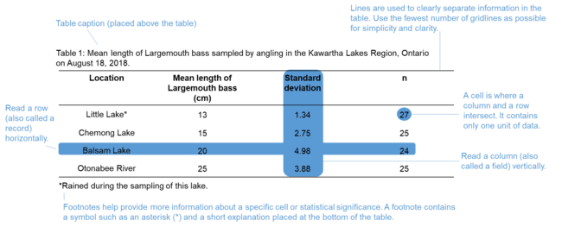
Example table with key elements

Slide 11
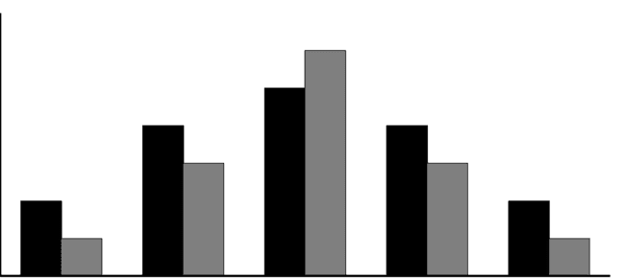
Figures

Slide 12
First step – determine the type of data you are working with
Continuous data – numbers measured on a continuum or scale (e.g. time, temperature, height, weight, length, etc.).
Discrete data – whole numbers that are usually counted (e.g. number of birds observed in the field, number of plants in a quadrat, etc.).
Categorical data – represent categories such as characteristics, names, or labels (e.g. fish species, blood types, income levels, etc.)

Slide 13
Second step – determine the dependent and independent variables
A coordinate grid has two perpendicular lines called axes.
The horizontal axis of a coordinate grid is known as the x-axis.
The independent variable is usually on the x-axis.
  The independent variable changes and influences the dependent variable.
The dependent variable is on the vertical line or y-axis.
  The dependent variable is a variable that responds to change.

Slide 14
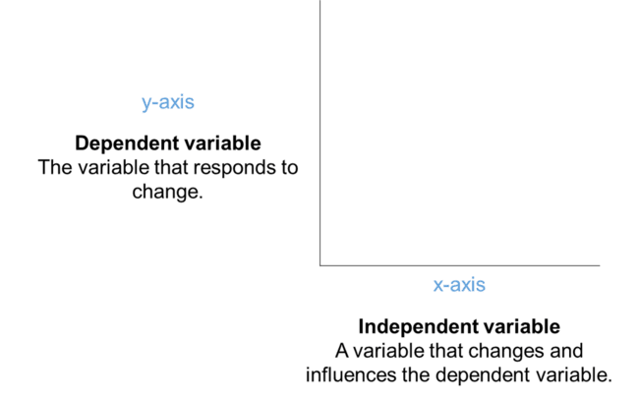
Example Coordinate Grid

Slide 15
Third step – pick the most appropriate figure to portray your data
Use the following as a guideline:
Line graph – depicts relationships between continuous data. Consider using when showing trends over time (e.g. temperatures recorded at the Trent Climate Station since 1992).
Scatterplot – depicts relationships between continuous data. Scatterplots are frequently used when you have two variables and one is dependent on the other (e.g. comparing the length and weight of individual fish). However, it is still possible to use this type of graph to depict relationships without a dependent variable.
Histogram – generally used to group continuous or discrete data into ranges to determine how frequently a value occurs (e.g. determining the most common weight of individual frogs included in a study).
Bar graph – compares proportions or count data. Consider using when the independent variable is not continuous (e.g. comparing the height of different tree species).

Slide 16
Third step (continued) – pick the most appropriate figure to portray your data
Use the following as a guideline:
Map – portrays spatial data (e.g. locations of study sites).
Diagram – simplified illustrations that represent connections or relationships between ideas, concepts, structures, or equipment (e.g. a diagram depicting the effects of climate change on precipitation and temperature).
Photographs or drawings – detailed and accurate illustrations of experimental equipment in the field or laboratory, organisms, cell structures, or medical conditions (e.g. a leaf’s structure under a microscope).

Slide 17
Figures – Graphs
Graphs are a type of figure that show relationships between different variables.
Four common types of graphs are:
  Line graphs
  Scatterplots
  Histograms
  Bar graphs

Slide 18
Line graph
Depicts relationships between continuous data.
There is usually only one data point for each unit of x.
Plot data points using x and y coordinates and connect them by a line.
Line graphs are useful to reveal the rate of change between individual data points.

Slide 19
Key elements of a Line Graph
When you create a line graph, remember to
  Use an appropriate scale (remember you are trying to show changes between data points)
  Label the y-axis and indicate the unit of measurement
  Label the x-axis
  Remove grid lines
  Connect data points by a line
  Figure caption (placed below the figure)
Example on next slide depicts annual flow rates in cubic meters for Fishy River between 2000 and 2005 measured by area-velocity flow meters at the Pickerel Stop Monitoring Station.
  The year is on the x-axis and flow in cubic meters is on the y-axis.
  The lowest flow occurred in 2000 at 17 cubic meters. The highest flow occurred in 2004 at 22 cubic meters.

Slide 20
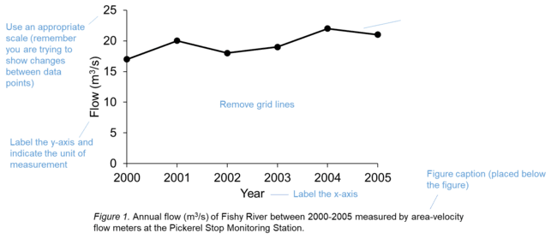
Example line graph with key elements

Slide 21
Scatterplot
Depicts relationships between continuous data.
There may be multiple data points for each unit of x.
Plot data points using x and y coordinates but do not connect them.
Scatterplots are useful to reveal:
  The overall strength of the relationship between variables (data points that are concentrated together = a stronger relationship and data points that are spread out = a weaker relationship).
  The direction of the relationship (positive, negative, or no relationship).
  The data pattern (linear/straight versus nonlinear/curved).
  Outliers (a data point that is highly different from the general trend).

Slide 22
Introduction to example Scatterplot
A scatterplot is a series of dots that represent data points. These dots are not connected by a line.
This example displays the relationship between the length in centimeters and weight of Largemouth bass in kilograms. Length is on the x-axis and weight is on the y-axis. Data are modified from Neumann (2017).
The graph indicates that longer fish will weigh more.
When creating a scatterplot, remember to label both axes, indicate the unit of measurement, remove grid lines, and place a figure caption below the figure.

Slide 23
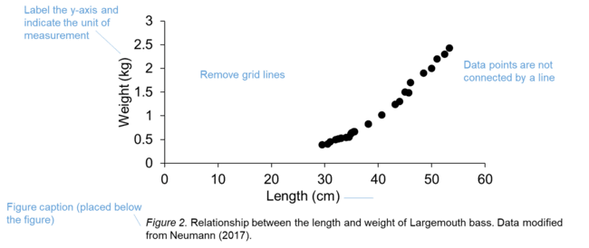
Example Scatterplot

Slide 24
Trend lines and Outliers in Scatterplots
Trend lines
  Sometimes you will need to include a trend line to further analyze a relationship between two variables or for predictive purposes.
  A trend line (also called the line of best fit) is a straight line or curve that depicts the general trend of the data. As a result, the trend line may not pass through all of the data points.
Outliers
  An outlier is set apart from the rest of the data points.
  An outlier could be a true, unusual result or may be due to error occurring during sampling, analysis, or data entry.

Slide 25
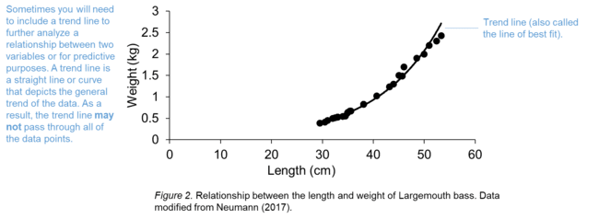
Example scatterplot with trend line

Slide 26
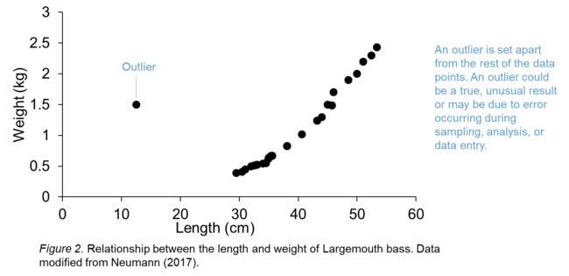
Example scatterplot with outlier

Slide 27
Histogram
Divides continuous data into logical groups/intervals to illustrate how data are distributed using vertical bars.
In histograms, the x-axis displays groups/intervals of data called bins. There should be a sufficient number counted within a bin. Software such as Excel or R will automatically calculate bin width to cover the range of values that exist in a data set. The y-axis shows the number of times a value appears in the dataset.

Slide 28
Histograms are useful to reveal:
The shape of the data – Is the data symmetrical or not? The data are symmetrical when they are normally distributed (i.e. bell-shaped). Data are skewed to the left when most of the data points bunch up at the left side of the graph. Data are skewed to the right when most of the data points cluster at the right side of the graph.
The shape of the data continued – Are the data unimodal, bimodal, multimodal, or uniform? The tallest vertical bars in the histogram are called peaks and represent the most frequent values in the data set. Unimodal means there is one peak, bimodal means there are two peaks, and multimodal means there are multiple peaks. When the data are spread equally across the data set without any peaks, the data are uniformly distributed.
The spread of the data – How variable is the data? If the data are clumped together they are narrowly spread. Alternatively, if the data cover a large range they are considered widely spread.
The center of the data – What is the central tendency of the data? The median can be used to measure the center of the data set in skewed distributions and the mean or median can be used for normally distributed data.
Any outliers in the data set.

Slide 29
Introduction to Histogram example
Histograms show the distribution of data using vertical bars that do not have any spaces between them.
The next slide shows an example of a histogram depicting the weight distribution of individual polar bears tagged and re-captured in a study area in northern Ontario.
Weight groups in kilograms are divided into 50 kilogram intervals on the x-axis and frequency is on the y-axis.
There were 21 polar bears weighed in this study and the histogram indicates that eight individuals weighed between 50 to 100 kilograms. The next highest grouping is between 150 to 200 kilograms followed by a grouping between 100 to 150 kilograms. Lastly, there were two individuals that weighed between 200 and 250 kilograms and two more that weighed between 250 and 300 kilograms.

Slide 30
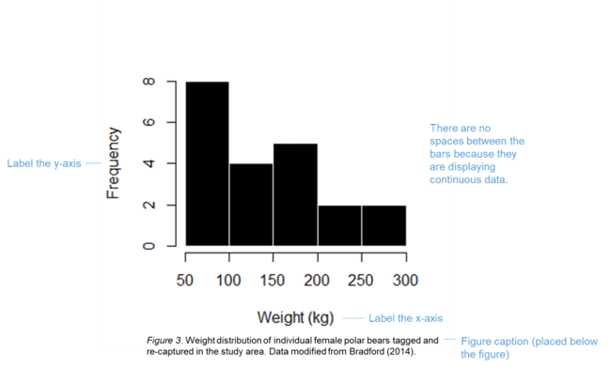
Example Histogram

Slide 31
Bar graph
Compares proportions or count data.
Consider using when the independent variable is not continuous.
Bar graphs are useful to see general trends.

Slide 32
Introduction to bar graph example
Bar graphs have vertical bars with spaces between them to represent data.
This example displays the mean length of Largemouth bass sampled by angling in the Kawartha Lakes Region in Ontario.
The location of the water bodies is on the x-axis and the length of the fish in centimeters is on the y-axis.
Little Lake had the smallest fish and Balsam Lake had the largest fish.
When creating a bar graph, remember to label both axes, indicate the unit of measurement on the y-axis, remove grid lines, include error bars if you are displaying means, and place a figure caption below the figure.

Slide 33
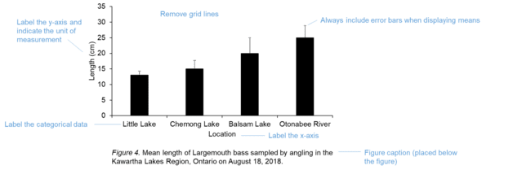
Example Bar Graph

Slide 34
What is the difference between histograms and bar graphs?
Histograms depict the shape, spread, and central tendency of data whereas bar graphs compare variables.
Histograms do not have a space between their bars because they are displaying continuous data that are grouped into intervals. Bar graphs have spaces between their bars because they display categorical data.
Grouped bar graphs use vertical bars with different colours or shading to show sub-groups of the main variable.

Slide 35
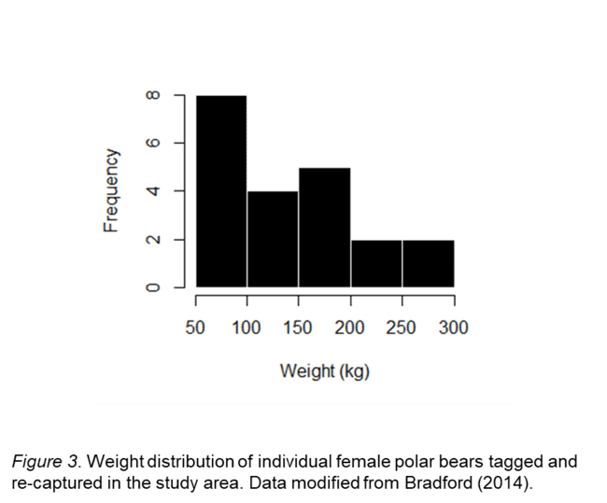
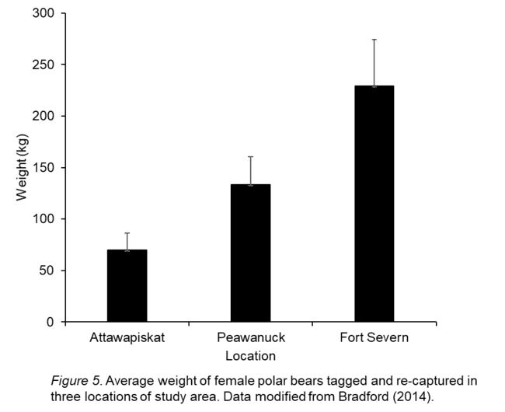
Histograms versus a single bar graph - example
Histogram
Single Bar Graph

Slide 36
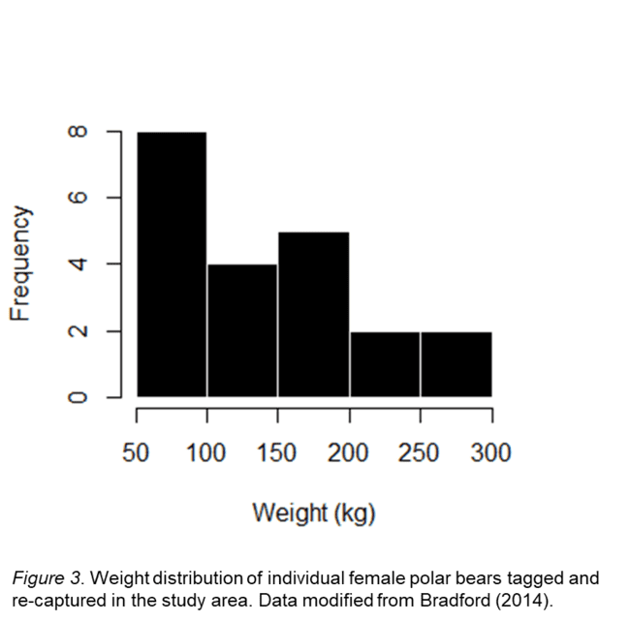
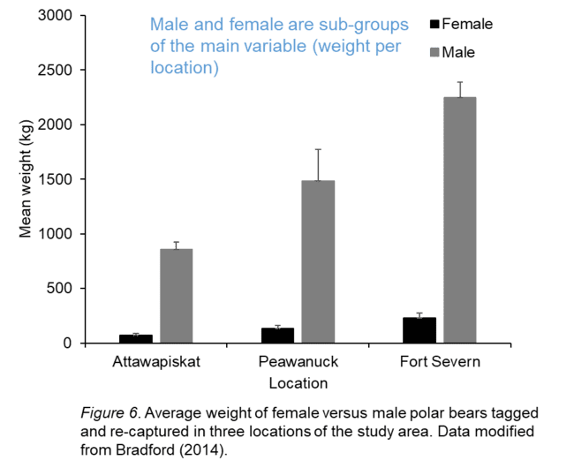
Histogram versus a grouped bar graph - example
Histogram
Grouped bar graph

Slide 37
A few more tips about graphs…
If you are submitting a hardcopy of your work, choose colours that will differentiate between variables in the graph even if it is printed in greyscale.
Format the size of your graph, font, and symbols based on the referencing style you are using.

Slide 38
Other types of figures
Maps
Diagrams
Photographs

Slide 39
Key Elements of a Map
Include a map as a figure to show the study area
When adding a map to a document, remember to include:
  latitude and longitude, if possible
  a scale bar,
  a figure caption.
It is also valuable to label any important feature you would like to highlight.

Slide 40
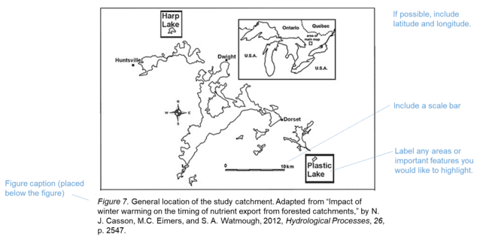
Example Map

Slide 41
Introduction to Diagram Example
Diagrams show connections between ideas or concepts.
This diagram shows the relationship between human activities and resulting impacts such as increased greenhouse gas emissions and water consumption. In turn, this reduces water discharge rates. Other factors impacting water discharge rates include ultraviolet radiation, agricultural pollutants, industrial pollutants, eutrophication, introduced exotic species, and acidification. Changes in water discharge rates may negatively impact fish species.

Slide 42
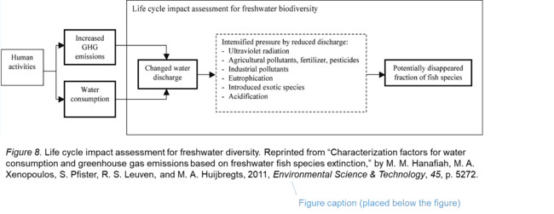
Example Diagram

Slide 43
Key Elements of Photograph or Drawing
Make sure your photographs are in focus and that the background that does not overpower your object of interest.
Label any areas or important features you would like to highlight.
Include a scale
Include a descriptive caption below the figure
When it is appropriate, multiple graphs or photographs can be combined in a single figure (this is called a multi-panel figure).
  Each part of the figure must be labelled with a letter (a, b, c, etc.) and described in the caption. Capitalize and format the letters depending on the referencing style you are using.

Slide 44
Introduction to photograph example
This is an example of a multi-panel figure using two photographs.
Each part of the figure (i.e. each photograph) must be labelled with a letter (a, b, c, etc.) and described in the caption.
In this experiment, Xenopus laevis tadpoles were observed at various times post-infection from different treatment groups exposed to the Frog virus 3 (FV3) and varying levels of imidacloprid (IMI).
  The first photograph shows the FV3 control and IMI control treatment, and the animal exhibited no signs of infection 25 days post-infection.
  The second photograph shows the FV3 infected and IMI control treatment animal displays edema, discolouration, a swollen peritoneal cavity, and hemorrhaging within the tail 20 days post-treatment.

Slide 45
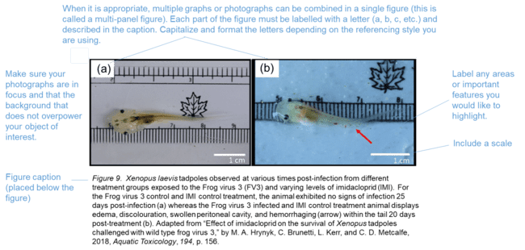
Example of multi-panel photograph

Slide 46
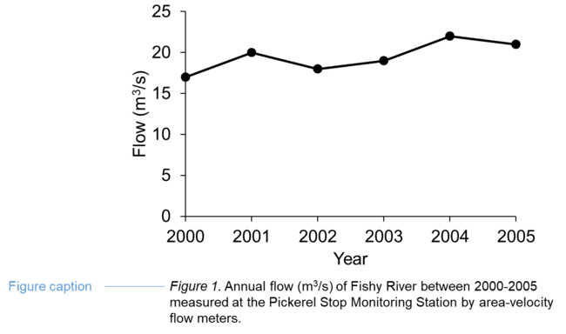
What is caption?
A concise description that helps your reader understand a table or figure without having to look at the rest of the document.

Slide 47
How do you make a caption?
Content:
Usually, a caption is a combination of a title and a brief description of the methods that were used to collect data.
A caption title describes the data (e.g. variables, time period, location, etc.) included in the table or figure.
Provide enough detail about the relevant methods (e.g. data collection methods in the field or laboratory, statistical techniques, materials used, etc.) so the reader can understand how to interpret the table or figure.
Example
Figure 1. Annual flow (m³/s) of Fishy River between 2000-2005 measured at the Pickerel Stop
Monitoring Station by area-velocity flow meters.

Slide 48
Captions – Labels and numbering
Label the tables and figures (e.g. “Table _” and Figure _”) .
Number tables and figures in sequence based on the order they appear in a document. Note that tables and figures are numbered separately from each other (e.g. Table 1, Table 2, Figure 1, Figure 2, Table 3).
Refer to a table or figure by its label in text (e.g. Table 1 indicates that…). Use capitals if you are referring to a specific table or figure.

Slide 49
Captions – placement
Captions are placed below figures and above tables. Tables and figures are usually placed on the same page as their captions.
The placement of tables and figures in a document depends on your discipline. However, numerous disciplines prefer that you insert a table or figure as close as possible to where it is first mentioned in the text without disrupting the flow of your writing (e.g. at the end of a paragraph).

Slide 50
Captions – citations
You do not need to provide a citation if you are using original data.
Provide a citation if you are modifying a table, figure, or data.
Provide a citation if you are using the exact same figure, table, or data from an information source.
The specific formatting of your citation depends on the referencing style you are using.

Slide 51
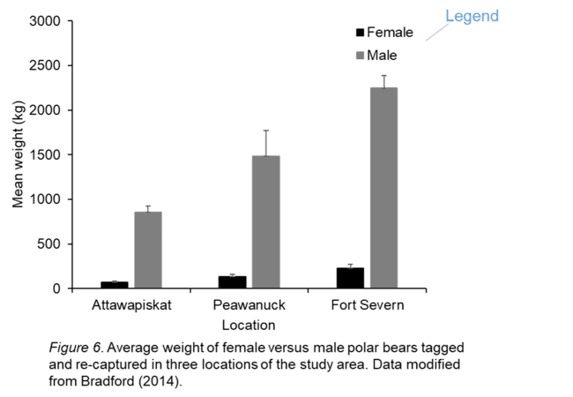
Captions and Legends
It is generally preferable to use a legend explaining what symbols or colours represent in a figure. However, if you do not have a legend you will need to describe any symbols, colours, or abbreviations in the caption.

Slide 52
References
Bradford, A. (2014). Polar bear facts. Retrieved from https://www.livescience.com/27436-polar-bear-
facts.html
Casson, N. J., Eimers, M. C., & Watmough, S. A. (2012). Impact of winter warming on the timing of
nutrient export from forested catchments. Hydrological Processes, 26(17),2546-2554.
Hanafiah, M. M., Xenopoulos, M. A., Pfister, S., Leuven, R. S., & Huijbregts, M. A. (2011).
Characterization factors for water consumption and greenhouse gas emissions based on
freshwater fish species extinction. Environmental Science & Technology, 45(12), 5272-5278.
Hrynyk, M. A., Brunetti, C., Kerr, L., & Metcalfe, C. D. (2018). Effect of imidacloprid on the survival of
Xenopus tadpoles challenged with wild type frog virus 3. Aquatic Toxicology, 194, 152-158.
Neumann, R. (2017). Largemouth bass length to weight conversion chart. Retrieved from
https://www.in-fisherman.com/editorial/bass-length-to-weight-conversion-chart/156649

