Slide 1
Introduction to R
Academic Skills, Trent University 2020

Slide 2
What is R? What is RStudio?
R is a free, open source software that you can use to manipulate, calculate, and analyze data.
RStudio is a free, open source software that interacts with R and makes it easier to use.

Slide 3
Step 1 – Download and install R
Download R before RStudio.
For Trent students – Go to the R homepage => Click on CRAN mirrors => Select Canada => Select University of Toronto
Choose the appropriate version of R for your computer’s operating system:
Windows
(Mac) OS X

Slide 4
Step 2 – Download and install RStudio
Remember, R is a programming language that tells your computer what to do. RStudio is a convenient interface to write commands in the R language. So you need to download Rstudio after you download R.
Go to the RStudio homepage => Download the free, open source version of RStudio Desktop

Slide 5
Using RStudio
To get started, open RStudio like you would any other software.
You should see three windows.
Open a fourth window by clicking File => New File => RScript.
Alternatively, you can click the green and white plus sign/blank document icon => RScript.

Slide 6
The four windows in RStudio

Slide 7
Description of the RStudio windows
RScript/Source Code Editor – the top left window – is a text editor where you can save your code.
Console – the bottom left window – sends the code to R to execute your commands.
Environment and History – the top right window – view a list of the objects available in your current R session (e.g. data sets, variables, matrices, etc.)
Files, Plots, Packages, and Help – the bottom right window – manage files, view plots, install packages, and access the help menu.

Slide 8
Using RScript
The lines of code in the RScript are numbered to help you stay organized and find errors more easily. Write your code and put your cursor on the line of code you want to run. Send it to the console which runs it in R by clicking on the “Run” icon or by typing “Ctrl + Enter”. Note if you want to run multiple lines of code at the same time, highlight them all and then send them to the console.
Code can be saved in the RScript as a .R file to be rerun or modified at another point in time.

Slide 9
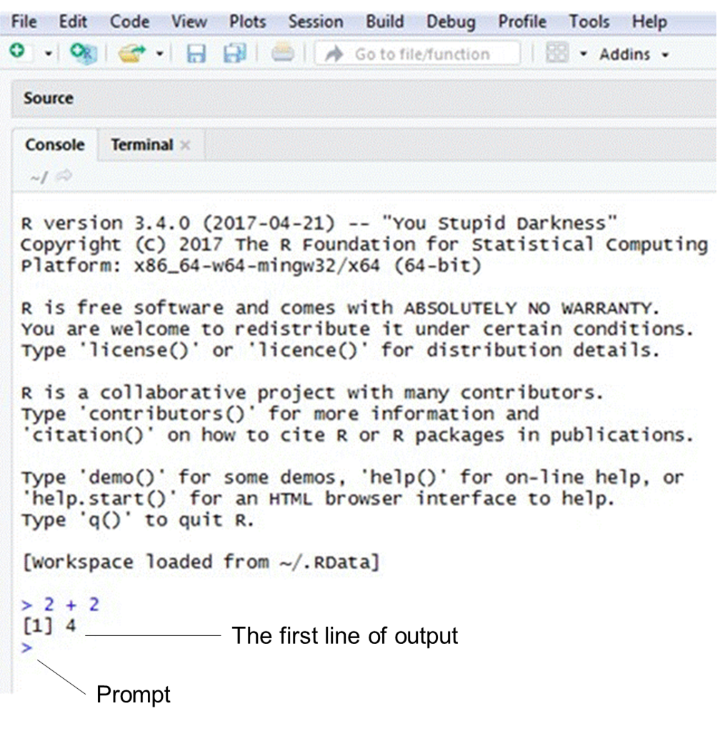
Using the console
If you click in the console, you should see a blinking cursor line (“|”) next to a greater than sign (“>”). This is called a prompt. You can write code next to the prompt and then press the “Enter” key to send the code to R.
The console displays any mistakes in your code (i.e. this is where you will receive error messages). In addition, the console shows your output (i.e. the results of your code) beside square brackets.
Note that any code written in the console will not be saved if you close RStudio. If you want to save the code, write it in RScript and then send it to the console.

Slide 10
What is an R package?
An R package is essentially a bundle of code and data that improves on R’s base capabilities or adds new abilities for R to manipulate, calculate, and analyze data.
When you install R for the first time, base packages are automatically installed.
If you would like to download a new package, use a Google search to determine the most appropriate one for your purpose and then install it.

Slide 11
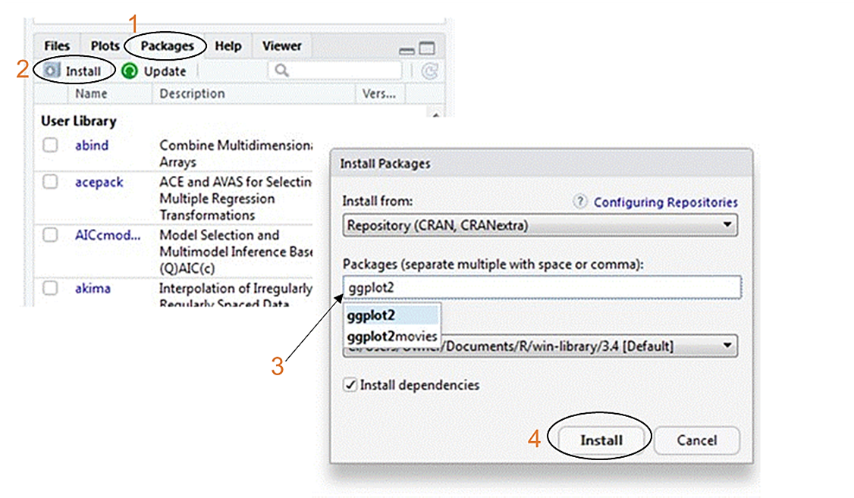
Install packages
There are two ways to install packages:
Go to the “Packages” tab => Install =>Type in the name of the package and click “Install”. Then wait for the package to download.
Use the following code: install.packages(“name of package”)
Example: install.packages(“ggplot2”)

Slide 12
Load packages
Packages only need to be installed once but they will need to be loaded every time you open a new R session and want to use them.
Use the following code to install a package: library(“package name”)
Example: library(“ggplot2”)

Slide 13
Load data
Every time you start a new R session you will need to load the data you want to work with.
There are numerous ways to start working with data in R. Three common ways are to use the built-in data, manually input data, or load a spreadsheet.

Slide 14
Built-in data sets
Use the following code to generate a list of data sets that came with the base package in R:
data()
If you run the name of any of these data sets, you can see the data contained within it.

Slide 15
Manually type in data
Create an object, assign values to it, click “Run”.
It is a good practice to annotate your code (i.e. provide a description) to remind yourself what you are trying to accomplish with your code. Use a number sign/hashtag (“#”) in front of your comments so that R does not read this as code.
Introduction to example (next slide):
This screenshot shows an example of code that creates an object and assigns values to it.
The code starts by naming an object "example".
To the right of this name is the less than symbol followed by a hyphen. This symbol means assign values to the object "example".
The next piece of code is a "c" which is the concatenate function and groups individual data points together. Then there is the data in an open parenthesis followed by a closed parenthesis.

Slide 16
Example of manually typed data

Slide 17
Upload data from a spreadsheet Step 1: Prepare the spreadsheet
Save an Excel spreadsheet containing the data you want to work with as a .csv (comma delimited) file.
Your spreadsheet cannot have multiple active worksheets, complex formatting (e.g. colours, fonts, cell types, etc.), and the names of the columns and rows should be as simple as possible with no blank spaces (i.e. use an underscore “_” or period “.” instead of a space).

Slide 18
Step 2: Load a spreadsheet to RStudio
Before you can load a spreadsheet, you need to tell R where to look for the file.
To do this, set the working directory by clicking on Session => Set Working Directory => Choose Directory => then select the folder on your computer in which you have stored your spreadsheet (.csv file). Any plots that you create in your R session will be saved to this folder.
This step must be completed before you enter the code in Step 3 otherwise the code will not work.
Use the following code to load the data: example <- read.csv(“example.csv", header = TRUE, sep = ",")

Slide 19
Errors
R will not execute a command if it is written incorrectly. If you have a mistake in your code, an error message will show up in the console.
Some of the most common errors occur due to the following:
Inconsistent capitalization and spelling or incorrect punctuation
Parentheses or brackets that have not been closed

Slide 20
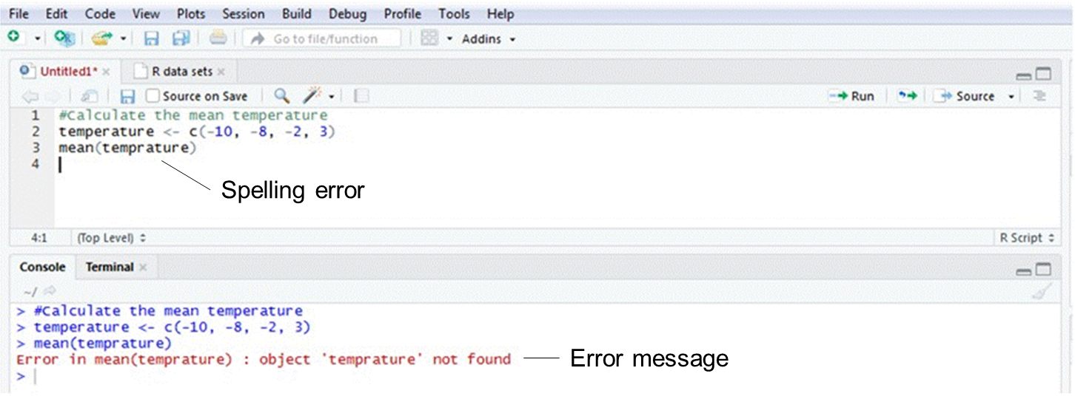
Capitalization, spelling, and punctuation
Use the same capitalization and spelling throughout your code.
Ensure you punctuation is correct. Commas separate components of the code so it is important to make sure they are in the right spot.

Slide 21
Brackets and parentheses
Make sure all your parentheses and brackets open and close (i.e. they should face forward and backward).
Example
( ) or [ ] or { }
Note: Parentheses, square brackets, and curly brackets mean different things and are not interchangeable. Most of the time you will use parentheses ( ).
In the RScript, corresponding parentheses and brackets will be highlighted in grey.

Slide 22
A plus sign (“+”) in the console
If the console displays a plus sign (“+”) it means something is missing (e.g. usually you have forgotten to close your parentheses) and R is waiting for you to add it.
Press the escape key (“Esc”) and then “Enter” to get back to the prompt (“>”).

Slide 23
Getting help
Use the following code to access the help menu:
help(“package or function name”)
Example
help(“ggplot2”)

